Slide 1
KEDL 2019
Smart and Open Technologies for Digital Library
Program Overview
Program Overview

Slide 2
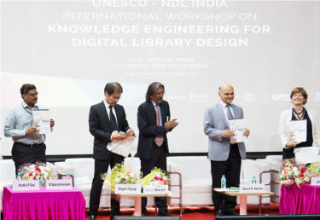
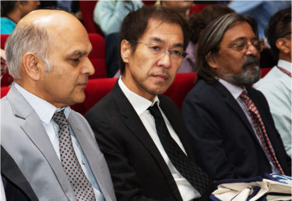
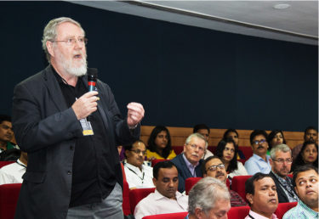
A Glimpse of the Past …… KEDL 2017

Slide 3
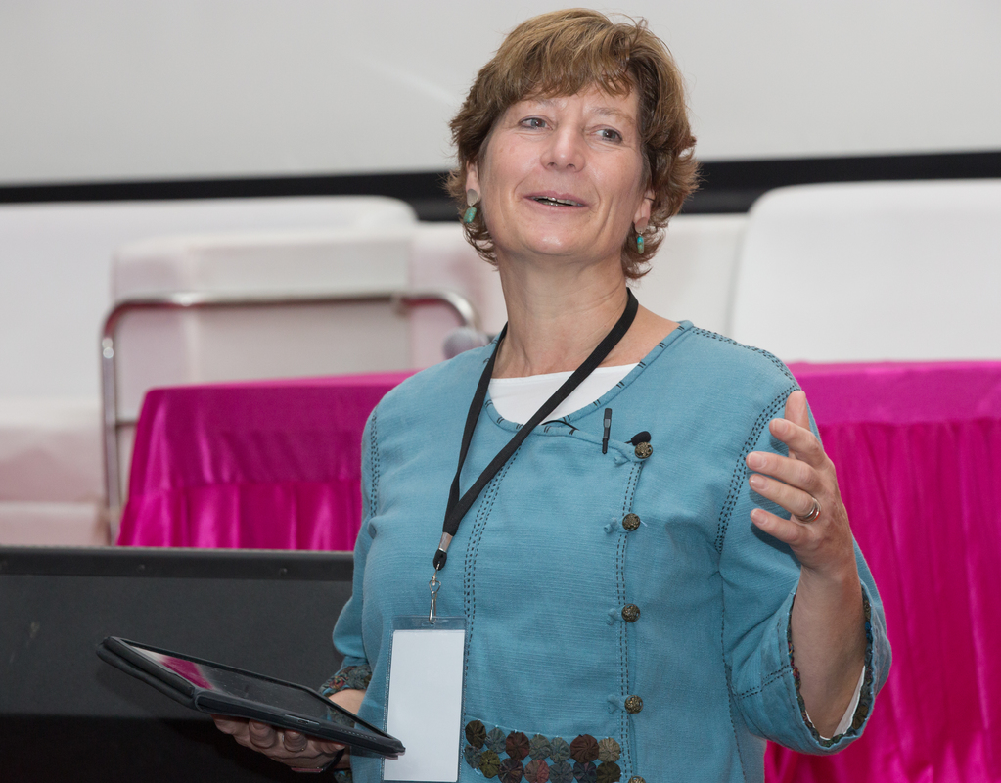
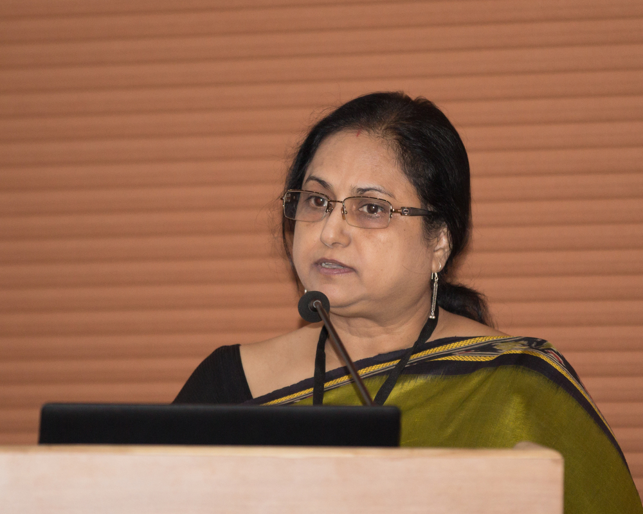
A Glimpse of the Past …… KEDL 2017

Slide 4
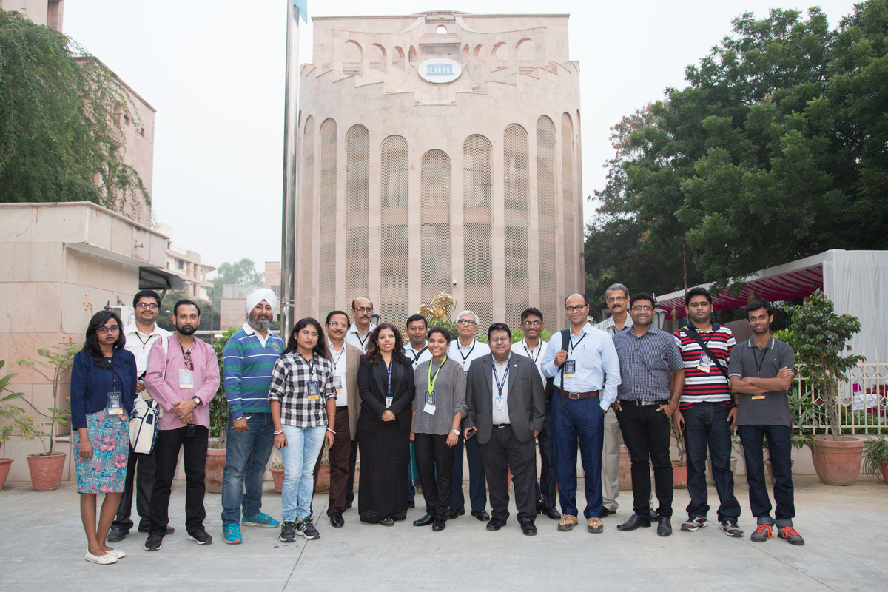
A Glimpse of the Past …… KEDL 2017

Slide 5
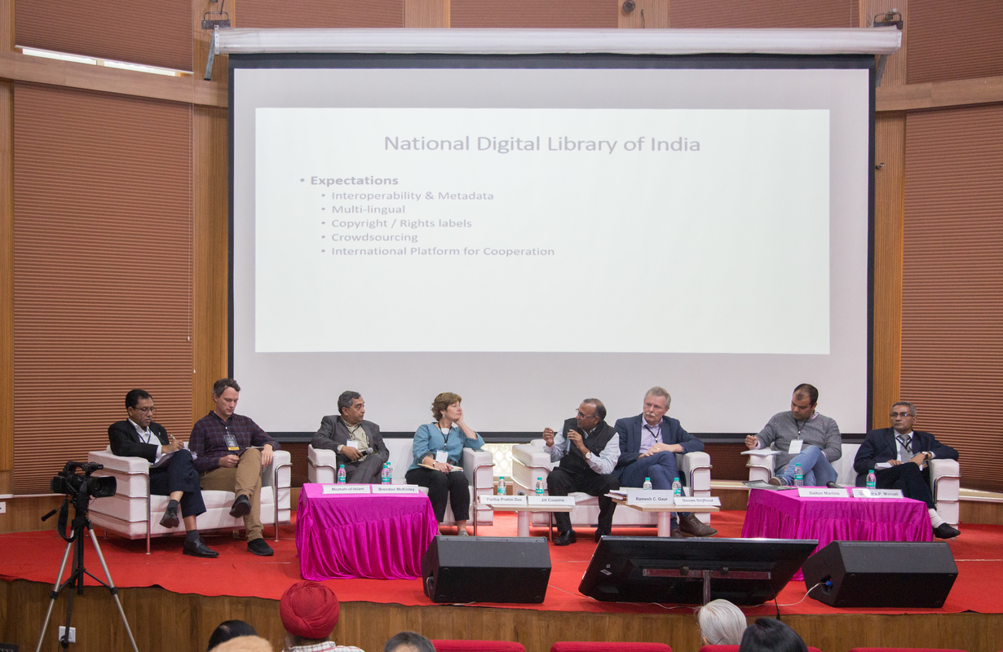
Convergence: “Openness is the key to mutual growth and sustenance”

Slide 6
Convergence: “Openness is the key to mutual growth and sustenance”
Smart and Open Technologies for Digital Library

Slide 7
User & Digital Library
Open Technology & Platforms
Cultural Heritage
Themes
Artificial Intelligence in DL
Access & Rights
11 Sessions, 20 Keynotes, 4 Panels, 40 Speakers

Slide 8
Europeana
National Digital Library of India
World Digital Library
User & Digital Library
Library Professional
Social Media & DL
DL Evaluation
DL Outreach Program

Slide 9
DBpeedia & Linked Open Data
Wikimedia & Global Heritage
Open Tech & Platforms
Linked Data in DL Architecture
Linked Data & Community

Slide 10
Immersive Visualization
Technology
Digital Reconstruction
Cultural Heritage
Digital Cultural Experience
Digital Preservation
SAARC Cultural Heritage Network

Slide 11
Text Mining in DL
Scholarly Knowledge Graph
Student Poster Competition
Artificial Intelligence in DL
Bias, Transparency & fairness
Geodetic Search
OCR & Document Retrieval

Slide 12
Open Culture in Education
IPR & Network of Libraries
Access & Rights

Slide 13
Thank You

