Slide 1
National Digital
Library of India

Slide 2
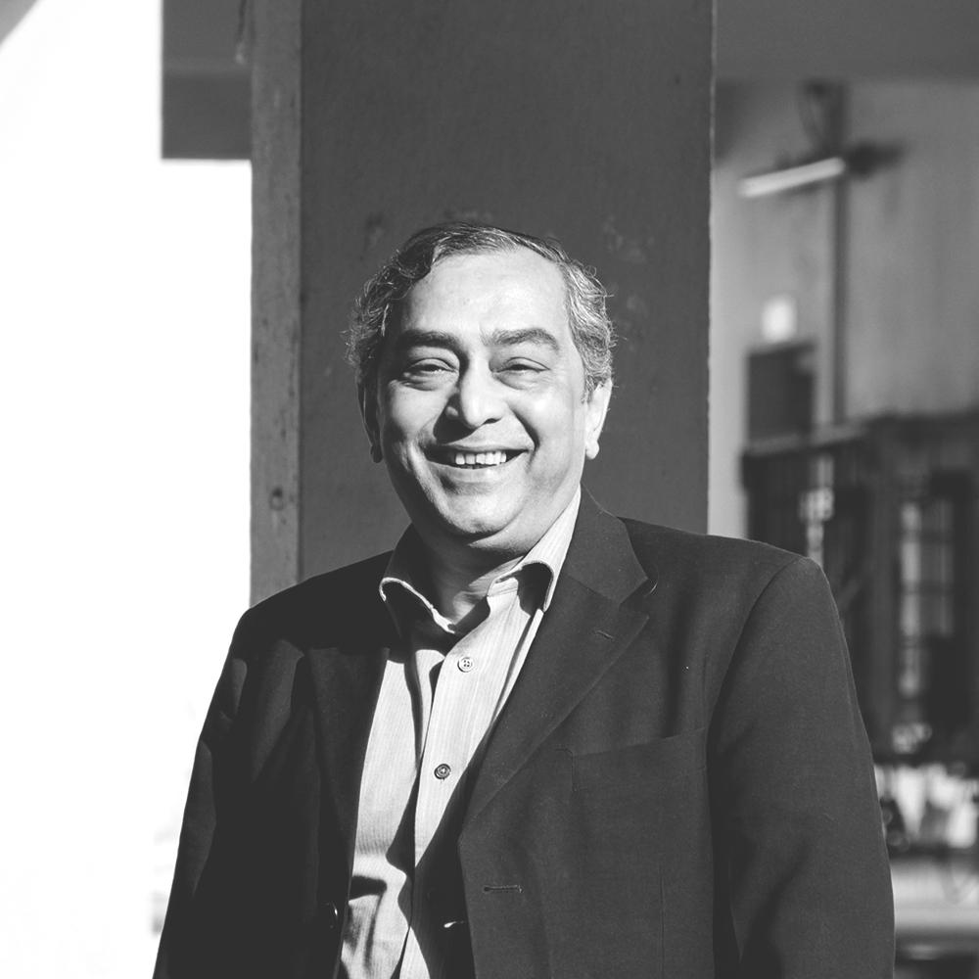
Prof. Partha Pratim Das
ppd@cse.iitkgp.ac.in
Professor, Department of Computer Science & Engineering,
Joint Principal Investigator, National Digital Library of India Project
Indian Institute of Technology Kharagpur

Slide 3
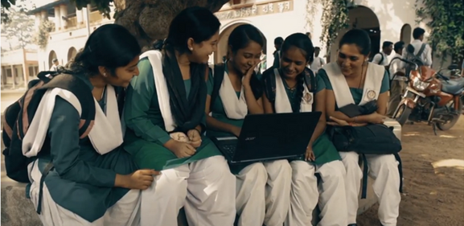
NDLI VISION
Build up NDLI as a National Knowledge and Cultural Asset:
The key driving force for Education, Research, Cultural heritage, Innovation and knowledge-sharing in India

Slide 4
NDLI MISSION
“IT IS HIGH TIME THAT INDIA SPEAKS FOR ITSELF, TO HIGHLIGHT, OFFER AND SHARE ITS OWN CULTURAL, SPIRITUAL, ACADEMIC AND SCIENTIFIC HERITAGE ON ITS OWN TERMS”
To create a 24X7-enabled integrated ubiquitous digital knowledge source
To protect and preserve India’s cultural, academic and scientific heritage
1
2

Slide 5
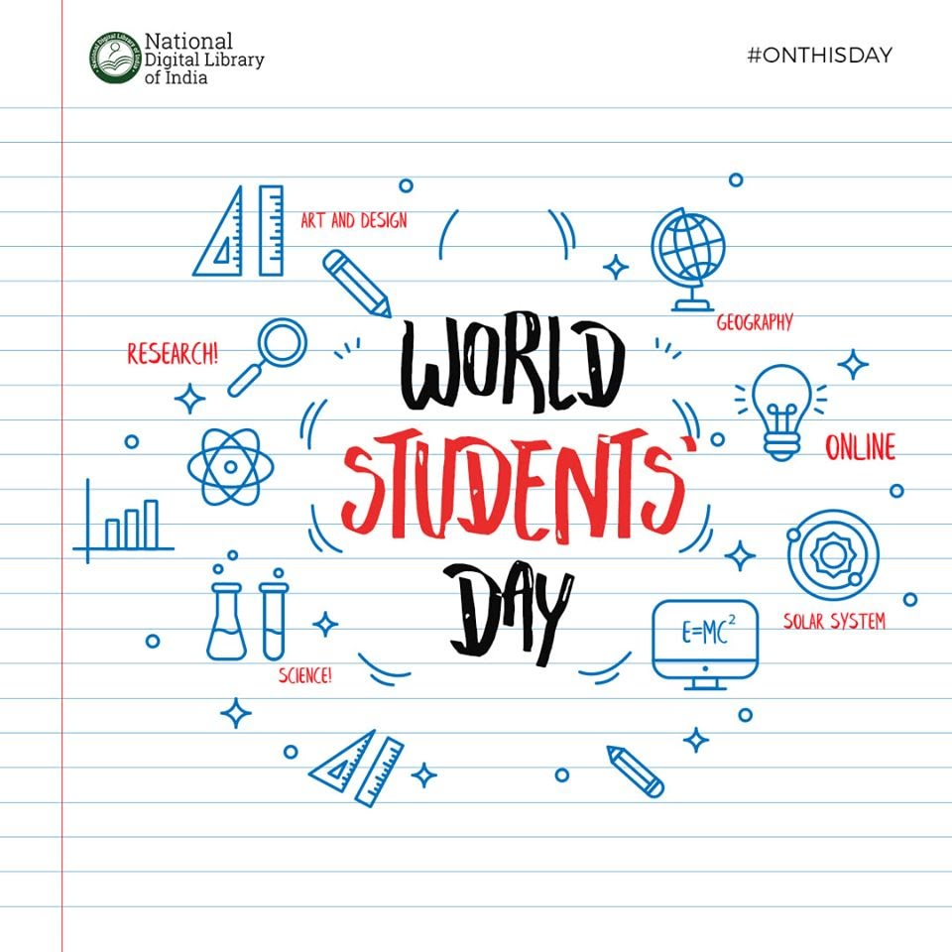
OPEN
NDLI MOTTO
INCLUSIVE
1
2
WINNER _{m}Billion^{th} South Asia Award 2017: in Learning and Education Category for Android Mobile App
WINNER: GEMS of DIGITAL INDIA 2019
for excellence in eGovernance

Slide 6
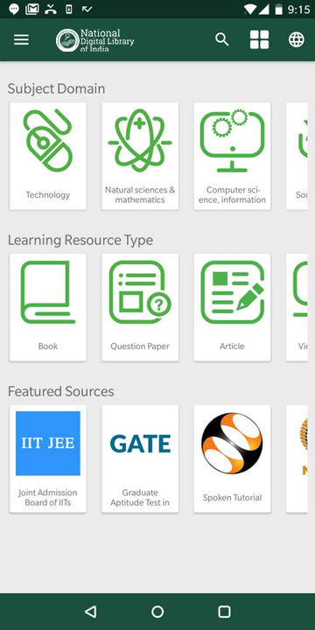
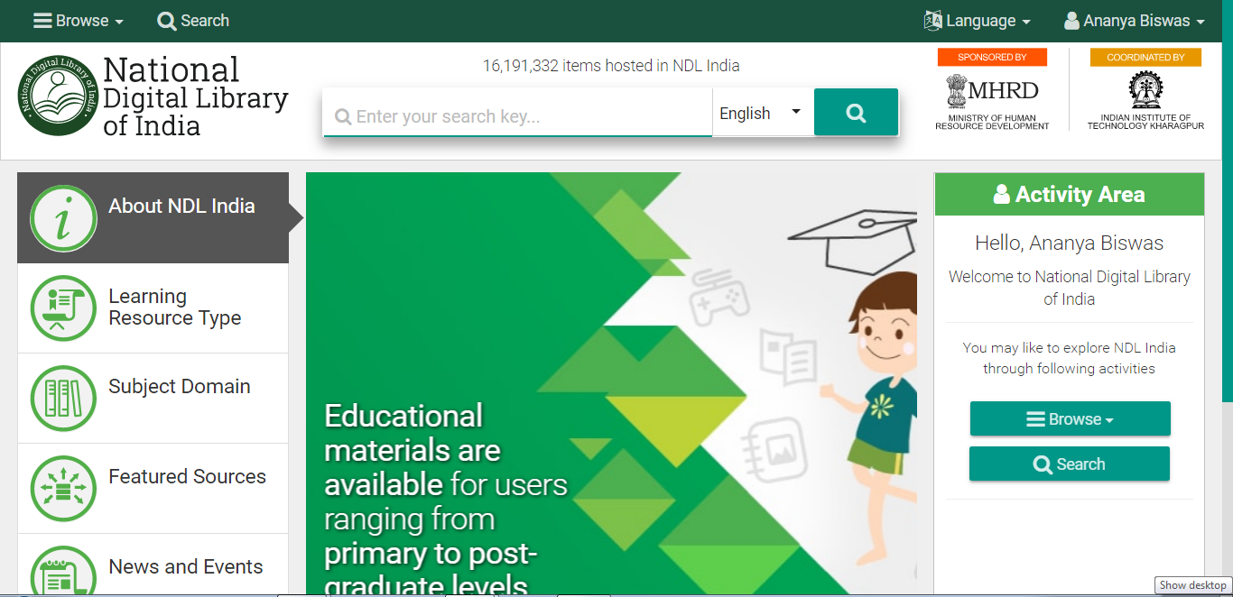
NDLI M-SITE: Landing page
NDLI WEBSITE: Landing page

Slide 7
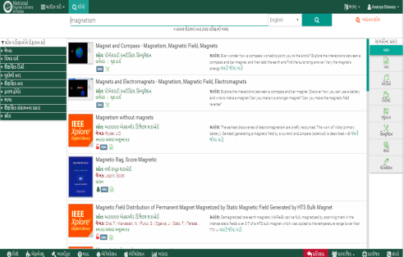
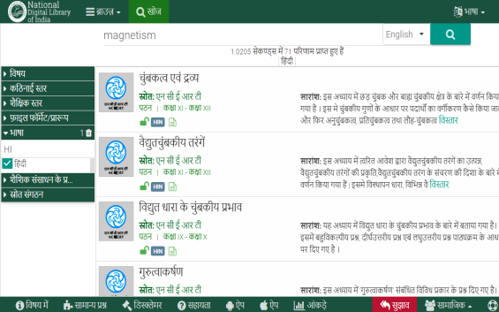
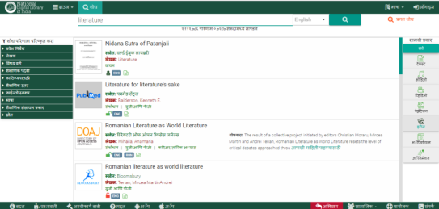
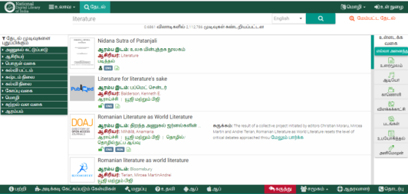
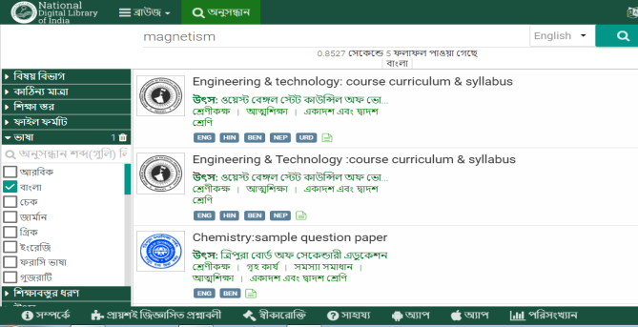
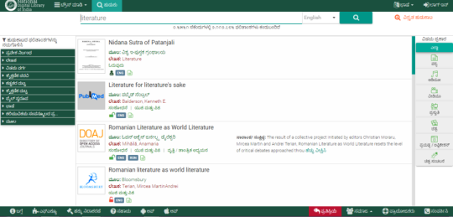
MULTI-LINGUAL INTERFACE: Promoting Indigenous Languages
NDLI MARATHI
NDLI GUJRATI
NDLI HINDI
NDLI TAMIL
NDLI BENGALI
NDLI TELEGU

Slide 8
HOW TO REGISTER?
LOG ON TO :
WWW.NDL.GOV.IN
Registration to NDLI is OPEN FOR ALL.
REGISTRATION TYPE:
Individual : Register directly
Institutional: Bulk registration managed by Institution overseen by authenticated nodal person as appointed by NDLI.

Slide 9
One Library All of India
A VIDEO TOUR

Slide 10
APRIL 2015
PILOT (PHASE-1) START
JUNE 2015
METADATA GENERATION AND CURATION START
NOVEMBER 2015
PORTAL HOSTING INFRASTRUCTURE
2015: CAN WE DO THIS?

Slide 11
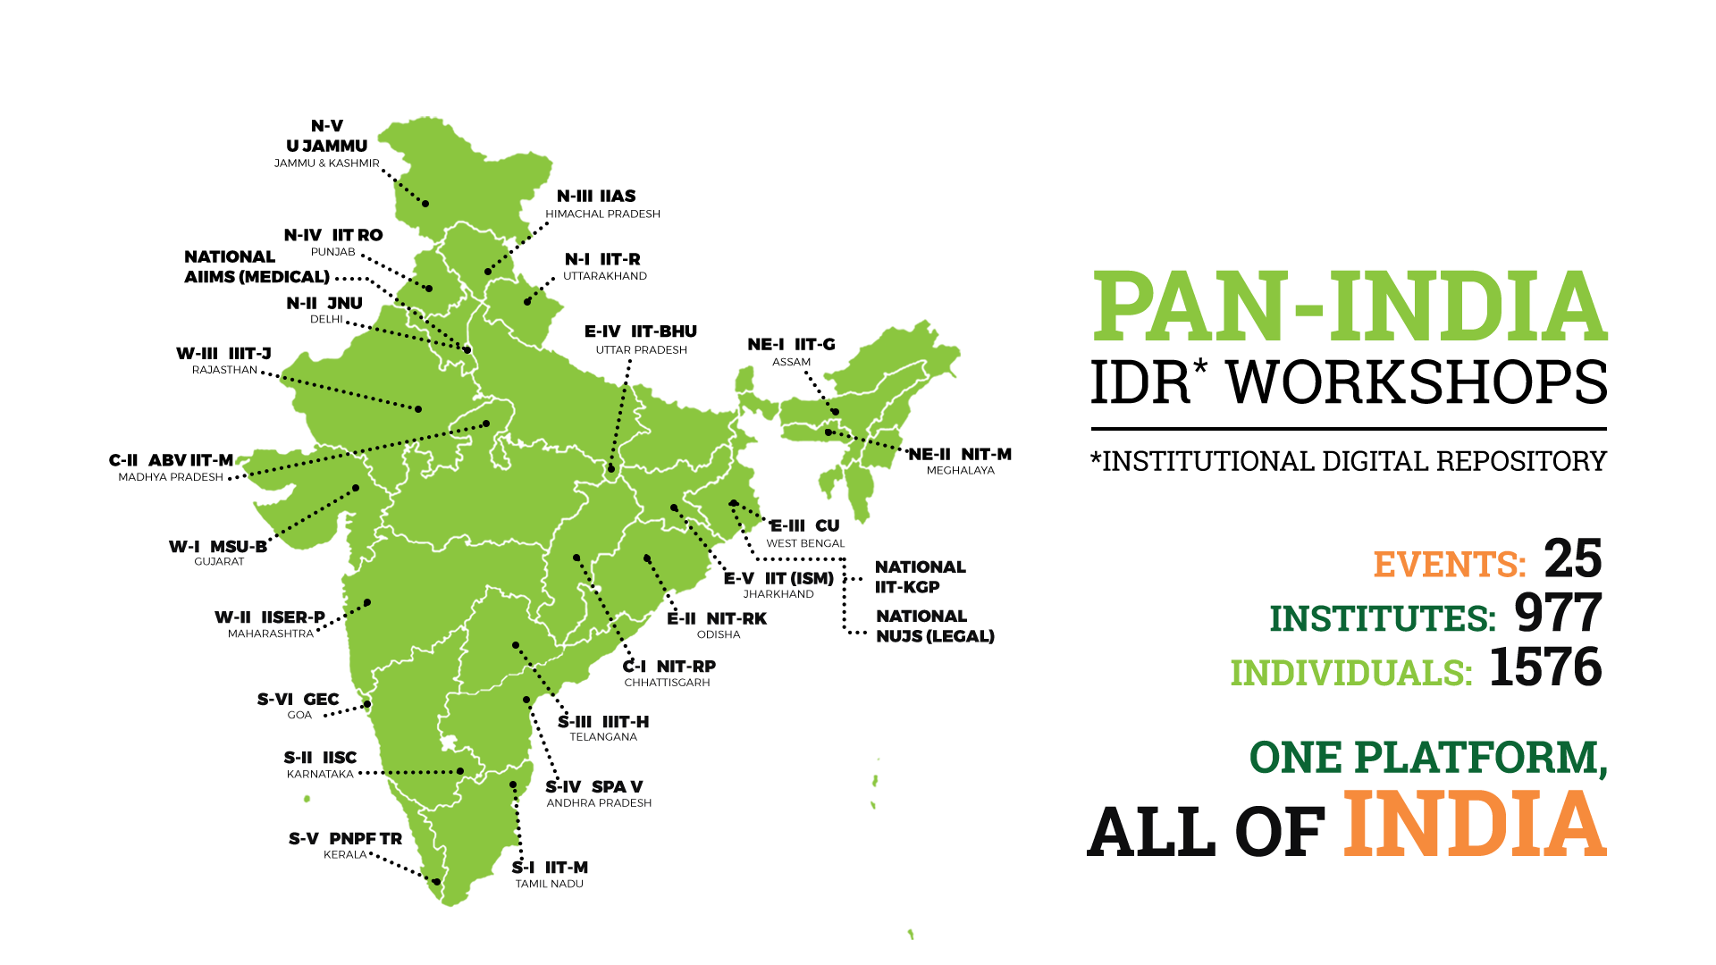
NATIONAL INITIATIVES

Slide 12
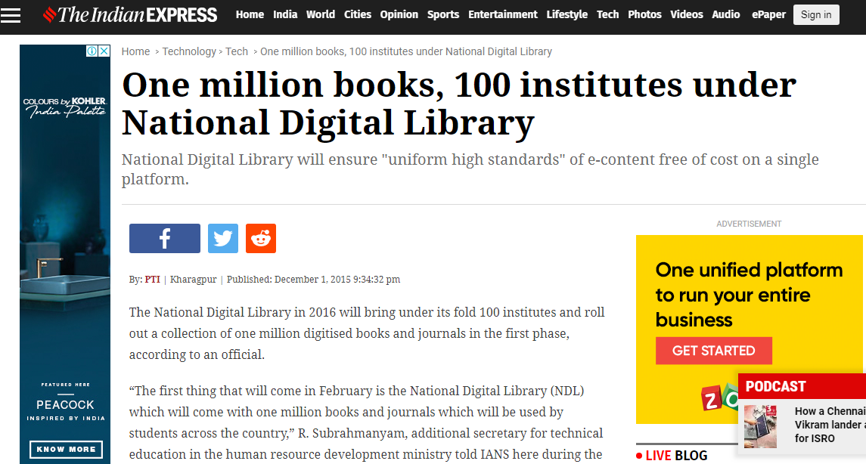
WE REACHED SOME NICE NUMBERS:
1.6CR+ content || 160+ premium sources || 200+ Languages || 30L+ Users

Slide 13
FEBRUARY 2016
PORTAL ALPHA RELEASE
NOVEMBER 2016
PORTAL BETA RELEASE TO EDUCATIONAL INSTITUTES
DECEMBER 2016
5 MILLION CONTENT
FEBRUARY 2017
MOBILE APP RELEASE
AUGUST 2017
10 MILLION CONTENT
1 MILLION ACTIVE USERS
OCTOBER 2017
PHASE II START
GROWING

Slide 14
REGIONAL CENTRES
- KEDL2017
PORTAL IN 8 LANGUAGES
EXPANDING ON OUTREACH
GROWING ON PARTNERS

Slide 16
MARCH 2018
15 MILLION CONTENT
1.5 MILLION ACTIVE USERS
OCTOBER 2017
KEDL 2017
19 JUNE 2018
LAUNCHED TO THE NATION
LOOKING FORWARD

Slide 18
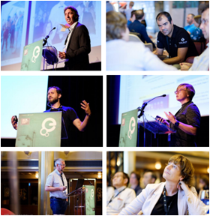
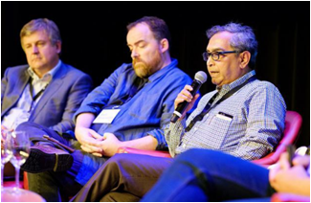
INTERNATIONAL OUTREACH
Representatives from National Digital Library of India regularly participate in both national and international workshops with the aim to:
Collaborate with institutions and organizations that are leaders in the field of library science and technology
Learn from existing knowledge portals and integrate key lessons into further developing NDLI
Share India’s culture, knowledge and technology inheritance with the world
1
2
3

Slide 19
TRADITIONAL LIBRARY
DIGITAL LIBRARY
Search
Browse
Borrow
Catalogue
Book Clubs
Reference
Catalogue
Book Clubs
Reference
Search
Browse
Borrow
SERVICES
More scale
Anytime access
Remote login
Multi-format data
Multimedia presentation
EXTENSIONAL
Data discovery
Compute databases
AI + deep learning – frontier research
DISRUPTIVE

Slide 20
DIGITAL LIBRARIES IN THE CONTEXT OF DIGITAL INDIA
WE NEED TO EQUIP THE FUTURE GENERATION WITH RELEVANT, APPLICATION-BASED SKILL TRAINING
MODE OF EDUCATION NEEDS TO ADAPT TO SMALL, DELIVERY BASED LEARNING
1
WE NEED ENABLE ACCESS TO QUALITY CONTENT FOR 1.3 BILLION PEOPLE SO THEY CAN LEARN, SHARE, GROW
2
ASSESSMENT NEEDS TO FOCUS ON OUTCOME RATHER THAN OUTPUT

Slide 21
DIGITAL LIBRARIES IN THE CONTEXT OF DIGITAL INDIA
DIVERGENCE AND PLURALISM NEEDS TO BE TACKLED WITH CONTINUOUS FORMATIVE ASSESSMENT
WE NEED TO BUILD MAN-POWER OF INTERNATIONAL STANDARDS SO INDIA CAN COMPETE IN GLOBAL MARKETS
3
CONTINUOUS TEACHER-TRAINING, NURTURING OF EDUPRENEURS, COLLABORATIVE AND DISRUPTIVE ED-TECH PROJECTS
WE NEED COST-EFFECTIVE AND COLLABORATIVE SOLUTIONS FOR ALL OF THE ABOVE
4

Slide 22
JULY 2018
NDLI MEDICAL IMAGE DATA PROJECT: CHAVI
OCT 2018
NDLI CLUB
OCT 2018
NDLI AI PROJECT
JAN 2019
OCR
JAN 2019
KOLKATA BOOK FAIR
SEPTEMBER 2019
RIGHTSSTAMENTS WORKSHOP
OCT 2019
NDLI READING OLYMPIAD
DECEMBER 2019
KEDL 2019
LOOKING BEYOND

Slide 24
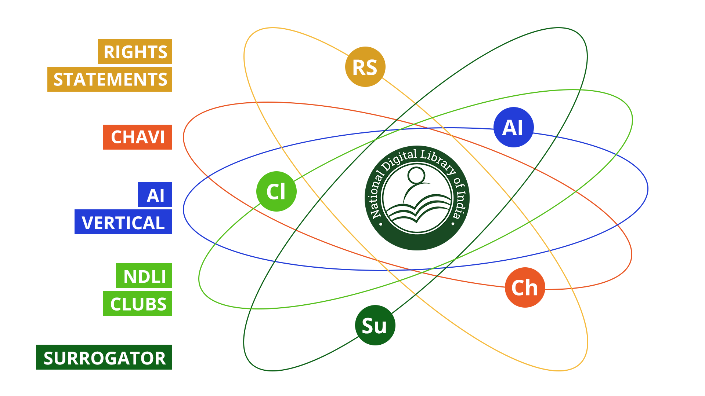
EXPANSIVENESS OF A DIGITAL LIBRARY
THE SCOPE OF A DIGITAL LIBRARY GOES MUCH BEYOND DATA STORAGE AND ACCESS

Slide 25
AI AND DIGITAL LIBRARIES
AI IN DIGITAL LIBRARIES
DIGITAL LIBRARIES IN AI
AUTOMATED METADATA
DATA LIBRARY
Benchmark Data
Annotated Data
Open License Data
SURROGATE
DISAMBIGUATION
ALGORITHM LIBRARY
Software
Processes
SEMANTIC SEARCH
COMPUTE PLATFORM
WEB ONTOLOGY
Cloud
INDIAN LANGUAGES IN DIGITAL LIBRARIES

Slide 26
AI IN DL:
PERSONALIZED LEARNING
Generic
Curricular
Experience Tracking
To offer customized search results
Multi-lingual Support
Reduce cognitive load for native use
Personalization
Customized UI to suit user grade
Multi-Aspect and Multi-Level Structured Prediction for Questions
Knowledge Tracing to estimate the level of knowledge of a student
Concept Ecosystem for Addressing Knowledge Gap
Cognitive Load Index of Concepts

Slide 27
AI IN DL:
SURROGATOR
1. QUERY
4. RESULTS + ACCESS RIGHTS
Makes available pre-print copies of academic resources that are otherwise unavailable to learners
A customizable application that can identify surrogates for access-restricted publications in digital libraries
Surrogator can make a case for the evolution of specific subject matters through pre-print indexing and open up a whole new realm of research
Application is being tested through NDLI, can easily be extended to other digital libraries
2. QUERY
SURROGATOR
5. FIND SURROGATES
3. RESULTS
8. SURROGATES
7. ARTICLES
+RELATED_ARTICLES + CITED_BY
6. CITATION

Slide 28
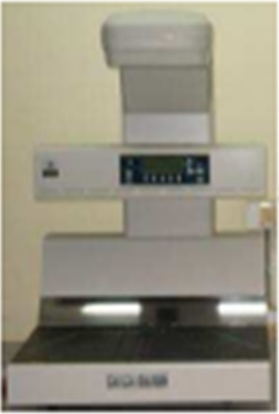
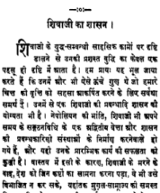
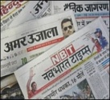
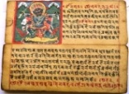
AI IN DL:
OCR FOR INDIAN LANGUAGES
OCR
Engine
Content
Languages
Search Index
Query
Multiple languages
Includes
- Hindi, Telugu, Tamil, Bangla.
Ranked Results

Slide 29
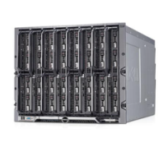
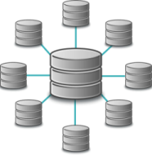
DIGITAL LIBRARIES AS A COMPUTING PLATFORM
DL IN AI:
Internal
Cloud AWS
Computer Server
Cloud Computer
Cloud Storage
Compute and Storage
Infrastructure
User-1
Access Mechanismand Policies
Data Storage
Cloud Setup Interface and Services
User-2
(Back-End) Processing
Units
(Front-End) Search-Compute Query Processing
Metadata Storage
NAIRP:
NATIONAL PLATFORM FOR AI
Ontology and Classification
Structured
Attributes
Query
Result
Knowledge
Graph Representation

Slide 30
DL IN AI
DATA-DRIVEN CANCER RESEARCH
India currently does not have the infrastructure for dedicated bio banks to aid medical research
This prevents the Indian medical system to learn of and from trends to prepare for subsequent treatment
NDLI has tied up with TATA MEDICAL CENTRE in Kolkata to develop a prototype for bio-banks that will aid cancer-research

Slide 31
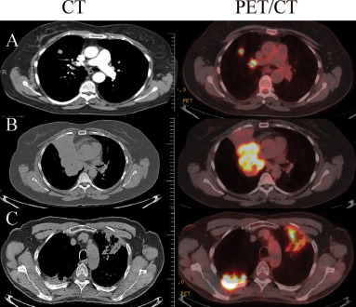
DL IN AI
CHAVI
COMPREHENSIVE DIGITAL ARCHIVE OF CANCER IMAGING
Dedicated image banking service
Will provide annotated images with associated information of cancer patients
Furthering India’s data banking initiatives
Library migrating to create a database for bio-banks

Slide 32
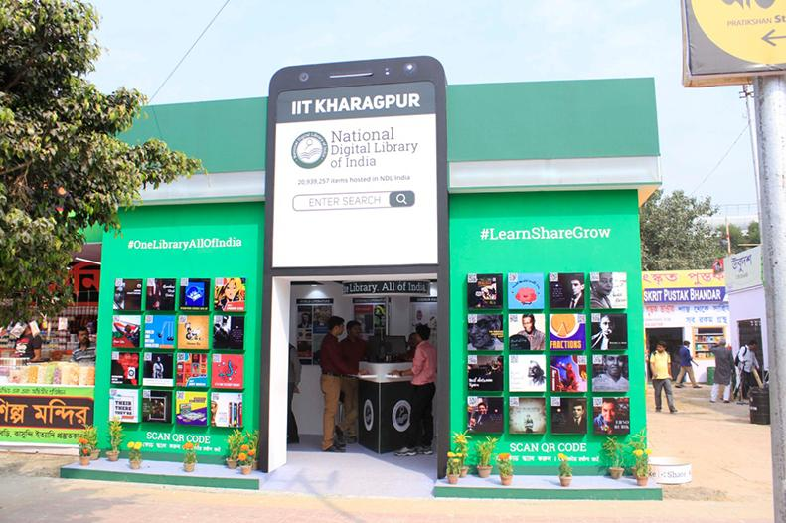
IT HAS BEEN A BUSY TWO YEARS

Slide 33
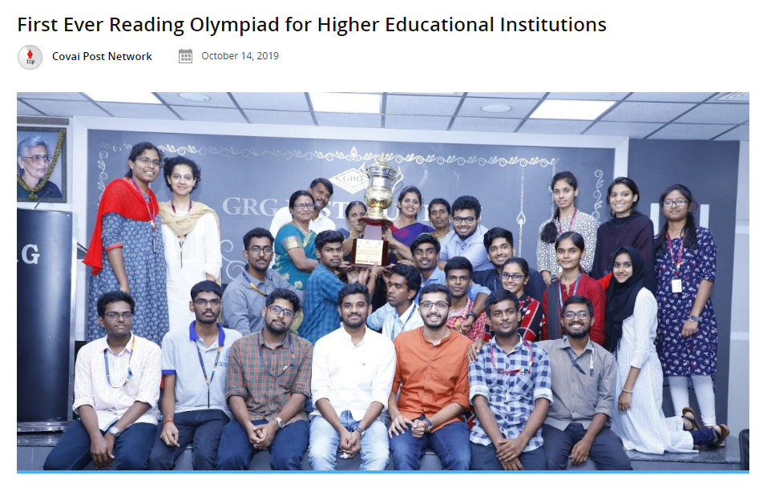

Slide 34
I’D LIKE TO LEAVE YOU WITH A COUPLE OF QUESTIONS BASED ON THE DELIBERATIONS TO FOLLOW…

Slide 35
Output Vs. Outreach Vs. Outcome
1
Rights and access
2
Linked Data – where are we headed?
3
What’s left and what’s right when it comes to Open Access?
4
Digital heritage and digital humanities – building bridges
5

Slide 36
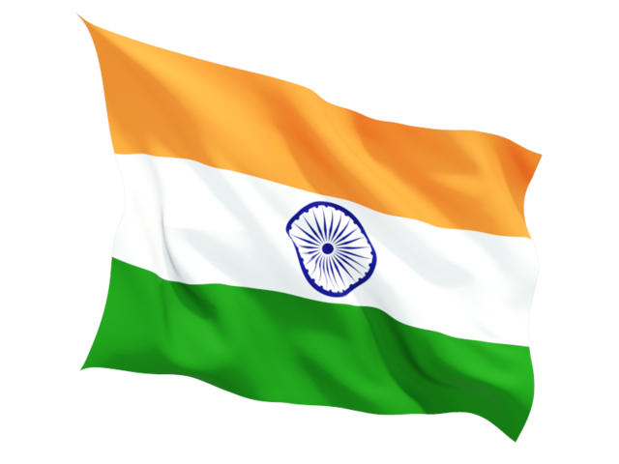
Dedicated to the Nation.
Together, let us
#LearnShareGrow
@NDLIndia
Use your e-mail address to sign up at
https://ndl.iitkgp.ac.in/
OR
https://ndl.gov.in/

