Slide 1
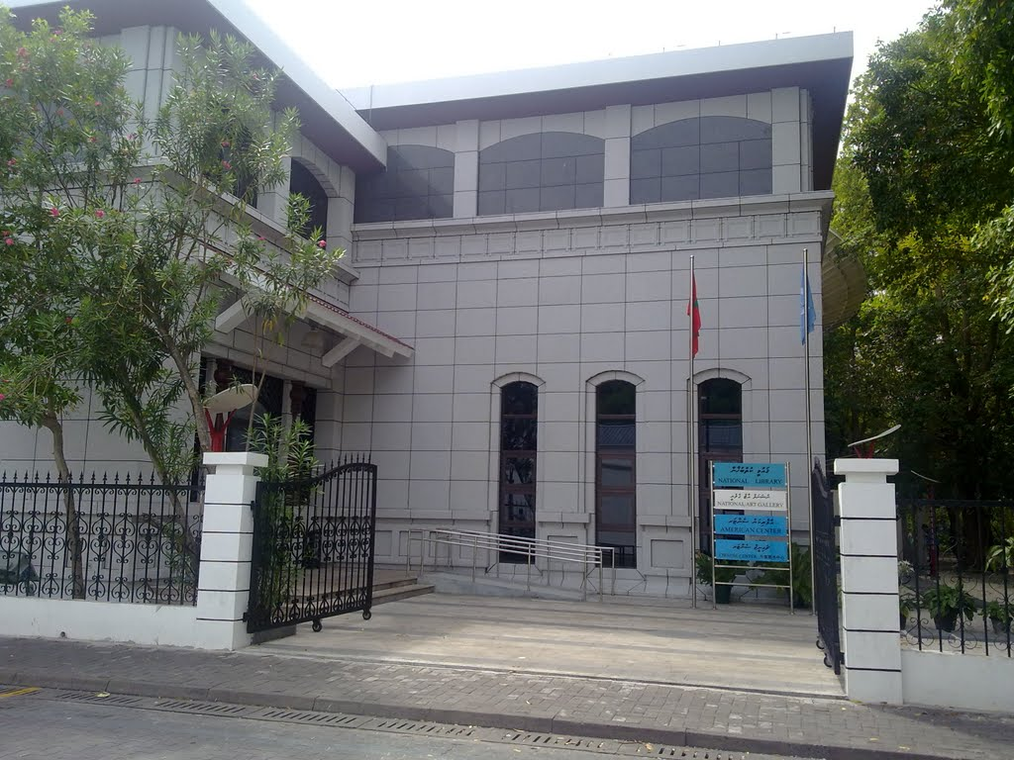
DIGITAL HERITAGE IN MALDIVES: challenges and opportunities
Aminath Shiuna
Director, Digitisation and Training Section
National Library, Maldives

Slide 2
Areas covered
Maldives
Role players
History and status of projects initiated
Challenges
Recommendations

Slide 4
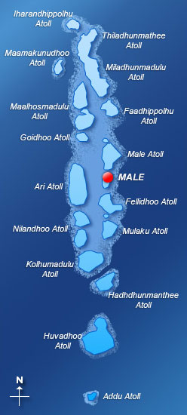
About Maldives
1190 islands
26 ring-like atolls that spread to 90,000 square kilometers
200 are inhabited
100 islands have been developed into resorts.
Tourism and Fishing are the two major industries
The resident population 533,941, of whom 196,774 are female and 337,167 are males.
Total Internet subscribers are 355,521
Total Mobile subscribers are 870,397
https://statisticsmaldives.gov.mv/maldives-in-figures-october-2019

Slide 5
Notes:
There are an estimated total of 294 libraries
National Library,
45 Public Libraries – except for one the rest operated by non-governmental organizations or individuals,
13 Special Libraries,
14 Academic Libraries – of which 7 are branch libraries of the Maldives University,
221 School Libraries - 21 school libraries are located in the capital Malé with the rest located in the remaining inhabited islands; the bulk of the school libraries operated by the government under the Ministry of Education.

Slide 7
Key role players
Ministry of Arts Culture and Heritage
National Library of Maldives
Department of Heritage
National Museum
National Archives of Maldives
Ministry of Education
National Institute of Education
National Center for Information Technology
Maldives National University
Maldives Library Association

Slide 8
National Library of Maldives
Established in 1945 is the oldest library in the country. It operates as the national library as well as the public library serving the entire Maldivian community.
NL is the main institution in the Republic of Maldives mandated with the development of the library and information science field.
Website
http://www.nlm.gov.mv

Slide 9
National Museum
The National Museum was opened on 11 November 1952
A diverse collection of artifacts are displayed in the museum
Digitisation of the object collection is an ongoing project
Website
https://archives.gov.mv

Slide 10
National Archives of Maldives
National Archives of Maldives is a public independent entity established under the Act (16/2011) on 19 January 2012.
About 601,514,240 public record documents in different storage facilities
Over 7,000,000 digital records in GEMS.
Public records digitalisation project is an ongoing work
Website
https://archives.gov.mv

Slide 11
Maldives Library Association (MLA)
MLA established, 1987, MLA council registered in 2010,
Strong advocate for libraries and librarians
Blog
http://infomalias.wordpress.com/
Newsletter
http://eepurl.com/1C8Fz

Slide 12
The Local Digital Repositories

Slide 13
Maldives Digital Library
Project was launched in August 2011 under the initiative of the National Library.
The Maldives Digital Library was created by the Maldives Greenstone Network (MGN).
National Library, Maldives (NL)
Maldives National University Library (MNUL)
National Centre for Information Technology (NCIT)
Department of Heritage
Maldives Library Association.
The MGN was formed with the help of a grant received by NL from the University of Waikato, New Zealand.
Website
http://library.egov.mv

Slide 14
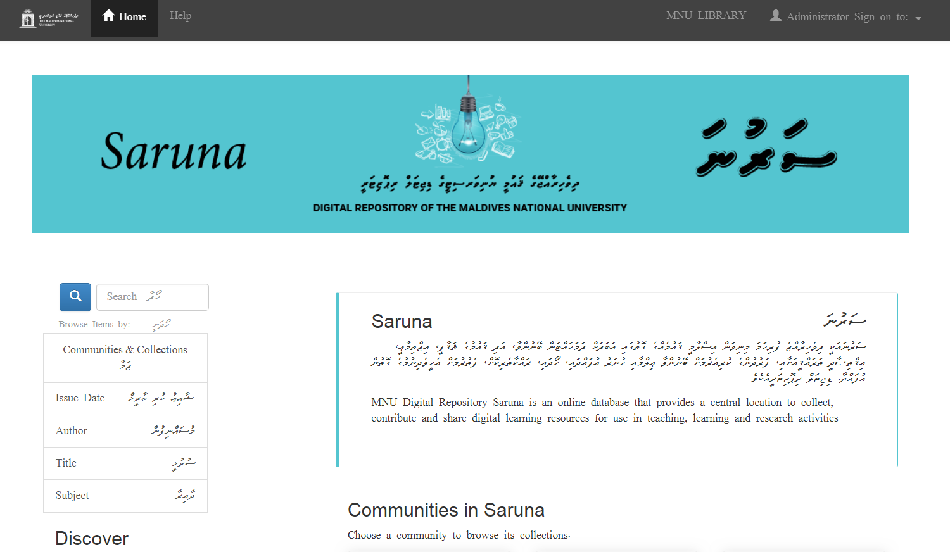
Saruna
Saruna is the digital repository of the Maldives National University and the repository was launched on 11 April 2018
Includes 7 main collections in multilingual
5411 files are uploaded in these collections
Website
http://saruna.mnu.edu.mv

Slide 15
Favvaru
Favvaaru digital repository was inaugurated on 9 July 2018 with one serial title namely ‘Faithoora’ which includes over 6000 articles.
Repository is managed by the Academy of Dhivehi Language.
Technical support and staff training was given by MLA.
Website
http://favvaaru.mv

Slide 16
Non-governmental
initiatives

Slide 17
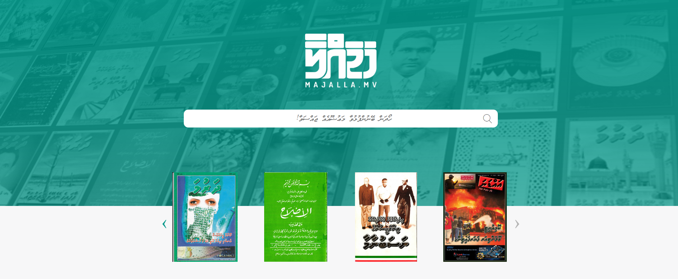
Website https://majalla.mv/

Slide 18
Website http://books.novelty.com.mv/v2/

Slide 19
Challenges
Lack of awareness on the importance of establishing these resources locally
Lacking the right skill set
Lack of internet facilities and equipment infrastructure
Budget limitation
Lack of quality control and poor indexing

Slide 20
Recommendations
To provide structured staff trainings to build the right skill set
To educate and create awareness among the high level policy makers
Asian countries/SAARC could create a joint digital repository
Leading to creating a Community of Practice for Digital initiatives in Asia.

Slide 21
Wishing for a constructive panel discussion to lead the way to a DIGITAL SAARC initiative.

