Slide 1
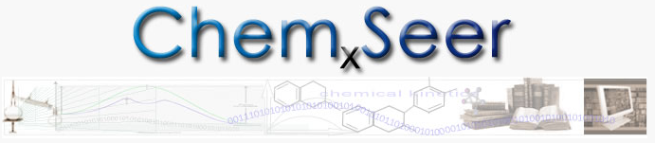
A Search Engine and Repository for eChemistry
C. Lee Giles, Prasenjit Mitra,
Chemistry, Computer Sciences and Engineering, Geosciences, Information Sciences and Technology
Pennsylvania State University, University Park, PA, USA
Funded by
NSF Cyberinfrastructure Chemistry
Microsoft
Dow Chemical
http://chemxseer.ist.psu.edu

Slide 2
Chem_{X}Seer Contributors/Collaborators: recent past and present (incomplete list)
Levent Bolelli, Xiaonan Lu, Saurabh Kataria, Ying Liu, Anuj Jaiswal, Kun Bai, Bingjun Sun, Isaac Councill, James Z. Wang, Karl Mueller, James Kubicki, Barbara Garrison, William Brouwer, Joel Bandstra, Qingzhao Tan, Juan Pablo Ramirez Fernandez, Na Li, Dayu Yuan

Slide 3
Motivation
“Fixing the past and present so we can fix the future.” Jeremy Frey
  Chemistry is an old discipline with publications going back 100 years
Large amount of useful data in documents
  Much data only available inside documents
  Give access to that data through search
Examples:
  Chemical formulae unique search
  Table search
  Figure search
  Experiment search
“Data from Big Science is … easier to handle, understand and archive. Small Science is horribly heterogeneous and far more vast. In time Small Science will generate 2-3 times more data than Big Science.” S. Carlson
Goals:
Create extensible public data repository, management and search for Small Science
Extract information and data from resources
Semantize chemical information
Create analysis tools

Slide 4
Research Approach
Integration of the following:
Special purpose parsers and pdf extractors for getting text, formulae, etc.
Automated feature extraction using
  State of the art machine learning methods
  Regular expressions
Entity disambiguation
Unique ranking methods
State of the art existing search and indexing systems
  Solr/Lucene
  SeerSuite
APIs for integration

Slide 5
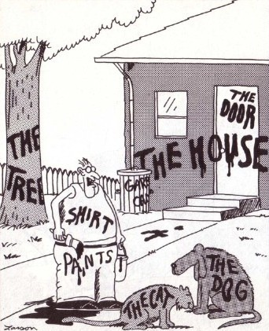
How will we get metadata?
Now... that should clear up a few things around here
Notes:
NL annotations (possibly with rendering annotation) already associated with images (only way google can find them)
Augment NL with semantic annotation.

Slide 6
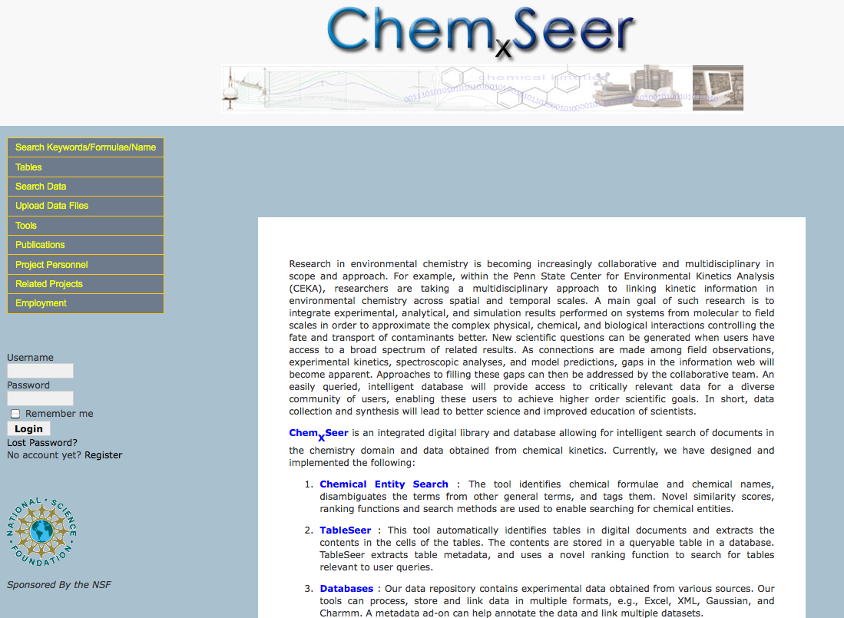
Based on cyberinfrastructure
for CiteSeer^{X}
Built on Solr/Lucene,
SeerSuite, other OSS

Slide 7
Chem_{X}Seer Formula Search
Extraction and search of chemical formulae in scientific documents has been shown to be very useful.
Intersection of two research areas:
  Information retrieval
  Chemoinformatics
Formulae cannot be treated as text.
  Domain knowledge (formula identification)
  Structural knowledge (substructure finding and search)
1D chemical graph theory
B. Sun, et.al., WWW 2007, WWW 2008, TOIS

Slide 8
Challenges in Formula Search
How to identify a formula in scientific documents?
Non-Formula
“… This work was funded under NIH grants …”
“ … YSI 5301, Yellow Springs, OH, USA …”
“… action and disease. He has published over …”
Formula
“… such as hydroxyl radical OH, superoxide O2- …”
“ and the other He emissions scarcely changed …”
Machine learning algorithms (SVM + CRF) yield high
accuracies for correct formula identification.

Slide 9
Segmenting chemical names
Goal: to discover semantically meaningful sub-terms in chemical names
  Methylethyl alcohol
  methionylglutaminylarginyltyrosylglutamylserylleucyl phenylalanylalanylglutaminylleucyllysylglutamylarginyl lysylglutamylglycylalanylphenylalanylvalylprolylphenyl alanylvalylthreonylleucylglycylaspartylprolylglycylisol eucylglutamylglutaminylserylleucyllysylisoleucylaspartyl threonylleucylisoleucylglutamylalanylglycylalanylaspartyl alanylleucylglutamylleucylglycylisoleucylprolylphenyl alanylserylaspartylprolylleucylalanylaspartylglycylprolyl threonylisoleucylglutaminylasparaginylalanylthreonylleucyl arginylalanylphenylalanylalanylalanylglycylvalylthreonyl prolylalanylglutaminylcysteinylphenylalanylglutamyl methionylleucylalanylleucylisoleucylarginylglutaminyllysyl histidylprolylthreonylisoleucylprolylisoleucylglycylleucyl leucylmethionyltyrosylalanylasparaginylleucylvalylphenyl alanylasparaginyllysylglycylisoleucylaspartylglutamylphenyl alanyltyrosylalanylglutaminylcysteinylglutamyllysylvalyl glycylvalylaspartylserylvalylleucylvalylalanylaspartylvalyl prolylvalylglutaminylglutamylserylalanylprolylphenylalanyl arginylglutaminylalanylalanylleucylarginylhistidylasparaginyl valylalanylprolylisoleucylphenylalanylisoleucylcysteinyl prolylprolylaspartylalanylaspartylaspartylaspartylleucyl leucylarginylglutaminylisoleucylalanylseryltyrosylglycyl arginylglycyltyrosylthreonyltyrosylleucylleucylserylarginyl alanylglycylvalylthreonylglycylalanylglutamylasparaginyl arginylalanylalanylleucylprolylleucylasparaginylhistidyl leucylvalylalanyllysylleucyllysylglutamyltyrosylasparaginyl alanylalanylprolylprolylleucylglutaminylglycylphenylalanyl glycylisoleucylserylalanylprolylaspartylglutaminylvalyllysyl alanylalanylisoleucylaspartylalanylglycylalanylalanylglycyl alanylisoleucylserylglycylserylalanylisoleucylvalyllysylisol eucylisoleucylglutamylglutaminylhistidylasparaginylisoleucyl glutamylprolylglutamyllysylmethionylleucylalanylalanylleucyl lysylvalylphenylalanylvalylglutaminylprolylmethionyllysyl alanylalanylthreonylarginylserine

Slide 10
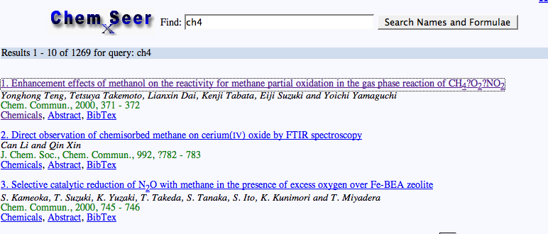
Example Formula Search

Slide 11
Chemical Entity Extraction and Tagging
Name tagging
  Each chemical name can be a phrase
  Example
    "... Determination of lactic acid and ...“
    "... insecticide promecarb (3-isopropyl-5-methylphenyl methylcarbamate) acts against ..."
Formula tagging
  Each formula is a single term
  Example
    "... such as hydroxyl radical OH, superoxide ..."
  Non-formula example
    "... YSI 5301, Yellow Springs, OH, USA ... ”
Tagging examples
  Name tagging:
    "... of <name-type>lactic acid</name-type> and ...“
  Formula tagging:
    "... radical <formula-type>OH</formula-type> , superoxide ..."
Notes:
The first data mining task is to detect chemical names and formulas from the literature.
So the task of entity tagging is to find the hidden labels of each term in the text

Slide 12
Chemical Entity Tagging examples
Name tagging:
  "... of <name-type>lactic acid</name-type> and ...“
Formula tagging:
  "... radical <formula-type>OH</formula-type> , superoxide ..."
...
of O
lactic B-name
acid I-name
and O
...
...
radical O
OH B-formula
, O
superoxide O
...
Notes:
these are examples of entity tagging formats.
Actually there are three types of labels for chemical name tagging, B-name means …, I-name means …, and O means …; obviously the label dependency is very strong, e.g. I-name will never appear just after a label of O.
For formula tagging, since each formula usually is a single term, there is only the label of B-formula. Even though there is some label dependency, it is not strong.

Slide 13
Independent Samples -Support Vector Machines
A binary classification method for independent samples, which finds an optimal separating hyperplane to maximize the margin between two classes
Good for high dimensional data
Non-linear kernels used for linearly non-separatable data
+
+
-
-

Slide 14
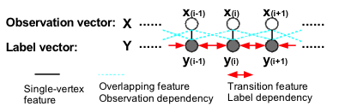

Dependent Samples -Conditional Random Fields
Undirected graphical models considering dependency of neighbors’ labels
State features
  single-vertex features and overlapping features
Transition features
Notes:
In the area of sequential data mining like entity tagging from the text documents, usually a chain model is used instead of a complicated graphs
CRF can solve some problems in HMM and allow arbitrary dependency
e.g. in HMM, observations are independent, given the hidden states (labels). Strong assumption, both X and Y are dependent.
So in CRF both of these two types of dependencies are modeled. there are two kinds of features. State features include single-vertex features and overlapping features, and transition features.
single-vertex features are only based on the observations of one vertex on the graph, while overlapping features are based on observations of adjacent vertexes.
Parameter is highly positive, if this feature appears often; otherwise, highly negative

Slide 15


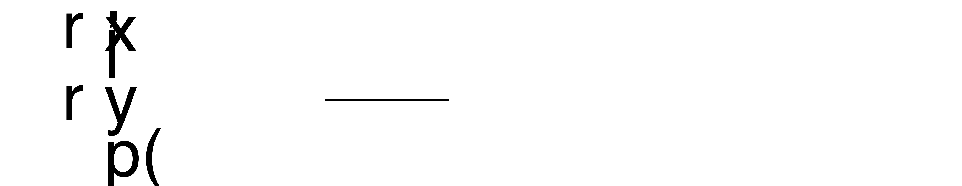
Dependent Samples -Conditional Random Fields
Probabilistic model
Maximum likelihood estimation
Testing samples
Notes:
Parameter is highly positive, if this feature appears often; otherwise, highly negative

Slide 16

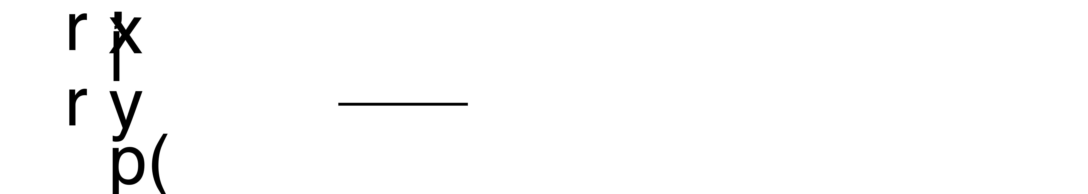


Imbalanced Data Classification and Tagging
Problem for imbalanced data
  Decision boundary is dominated by negative samples
  Precision is higher than recall
SVM
  Move the hyperplane from the positive class to the negative class during testing
Move this way
+
-
CRF
  During testing, boost the feature values of the positive class(es) to generate higher probability using parameters
  is a vector with when y_{i}=n.
Notes:
However, we observed an problem in our experiments. In most of the tasks of entity tagging, the data set is very imbalanced.
there are many previous approaches for classification methods to handle imbalanced data, e.g. under-sample negative data or over-sample positive data, or give different weights or costs to them. they require multiple training processes. We just use a simple way which only need one training process. And during the testing process, we just move the hyperplane from the positive class to the negative class and find the best position using CV.
No previous work for CRF to handle imbalanced data. Those approaches cannot be used in CRF directly, since CRF is not a method of independent samples and have more than two hidden labels. we proposed a method by introducing a boosting parameter to boost the feature values of positive classes and also corresponding probabilities.

Slide 17
Methods for Entity Extraction
Independent Samples - Formula
  Support Vector Machines
Dependent Samples – Name and Formula
  Conditional Random Fields
  Undirected graphical models considering dependency of neighbors’ labels
Notes:
For dependent samples, a traditional method is HMM. However, we used CRF, which is an undirected graphical model.
CRF can relax some assumptions in HMM and allow arbitrary dependency.
one of the assumptions in HMM, observations are independent, given the hidden states (labels). Strong assumption, both X and Y are dependent.
So in CRF both of these two types of dependencies are modeled.
In the area of sequential data mining like entity tagging from the text documents, usually a chain model is used instead of a complicated graphs
there are two kinds of features.

Slide 18
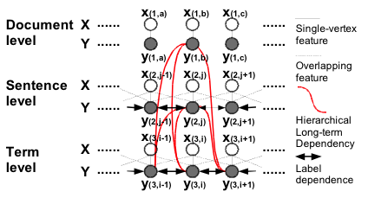
Hierarchical Conditional Random Fields
Consider long-term dependency
  E.g. sentenceTag_{i}=References and term_{i}=Is Formula Pattern
Notes:
Even though CRFs can model multiple and long-term dependencies on the graph, in practice only short-term dependency of adjacent nodes are considered. since long-term dependency is too complex and too many to consider.
However, sometimes long-term dependencies at higher levels of documents may be useful to improve the performance of entity tagging. For example, at the document level, non-chemical articles have much smaller probabilities of containing chemical formulas and names. At the sentence level, sentences in different sections have different probability and/or features for chemical names and formulas.

Slide 19
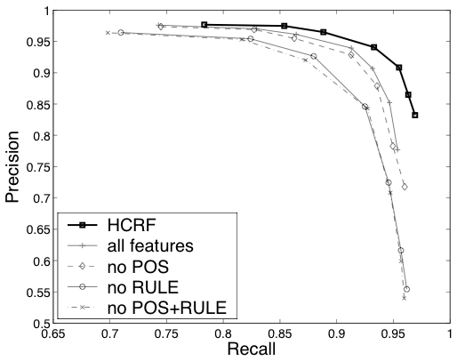
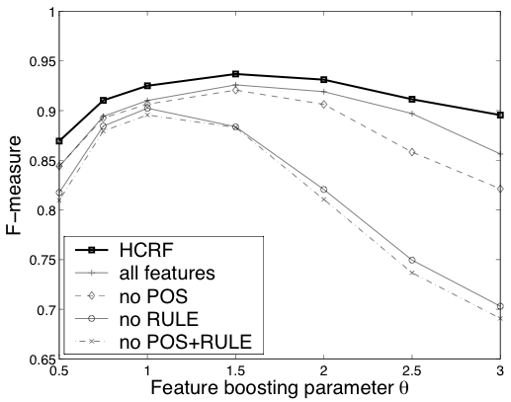
Formula Tagging
Contribution of different feature subsets
Notes:
we test CRF for chemical formula tagging using different feature sets, including hierarchical CRF that uses features at the sentence level.
We can see if more features are used, usually a better performance is expected. especially using HCRF, which utilizes information at the sentence level as features for formula tagging.

Slide 20
Text Pattern Mining and Segmentation

Slide 21
Textual Chemical Molecule Information Indexing and Search

Slide 22
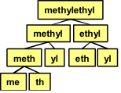
Textual Chemical Molecule Information Indexing and Search
Index Schemes:
  Which tokens to index?
  Indexing all subsequences generates a large size index
Segmentation-based index scheme
  Used for indexing chemical names
  First segment a chemical name hierarchically and then index substrings at each node
Frequency-and-discrimination-based index scheme
  Used for indexing chemical formulas
  Sequentially select frequent and discriminative subsequences of a formula from the shortest to the longest
Notes:
most of those substrings on the tree are semantically meaningful

Slide 23
Primitives for Formula Indexing
Formula
  A sequence of chemical element or partial formula with corresponding frequencies
  E.g. CH3(CH2)2OH
Partial formula
  Partial formula: a subsequence of a formula
  E.g. C, H, O, CH3, CH2, OH, CH3(CH)2, H3(CH)2, CH3(CH)2O, etc.
Index construction
  Partial formulas with frequencies: e.g. <C,3>,<H,6>,<CH2,2>, etc.
  Too many partial formulas, need feature selection

Slide 24

Criteria of Feature Selection
Criteria of feature selection
  Frequent features (Freq_{s}≥Freq_{min})
  Discriminative features (α_{s} ≥α_{min})
    If a sequence’s selected subsequences are enough to distinguish formulas containing them from other formulas, this sequence is redundant.
    Discrimination score
    where F is the selected feature set, and D_{s} is the set of formulas containing s.
Notes:
for the discriminative score of a subsequence s, the numerator is the size of the intersection of formula sets containing its selected subsequences,
and the denominator is just the size of the formula set containing s.

Slide 25
An Example for Formula Indexing
Data set:
  1.CH3COOH, 2.CH3(CH2)2OH, 3.CH3(CH2)3COOH
Parameter:
  Freq_{min}=2, α_{min}=1.1
Steps:
  Length=1, Candidates={C,H,O}, F={C,H,O}
  Length=2, Candidates={CH3,H3C,CO,OO,OH,CH2}, Frequent Candidates={CH3,CO,OO,OH,CH2}
  Frequent & Discriminative Candidates={CO,OO,CH2}
  F={C,H,O,CO,OO,CH2}
  Length=3, …

Slide 26
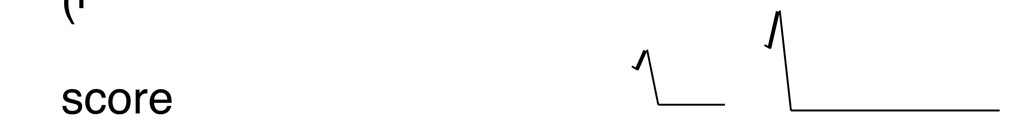
Formula Search
SF.IEF: Subsequence Frequency & Inverse Entity Frequency
Exact formula search
  Search for exact representations. E.g. =C1-2H4-6 matches CH4 and C2H6, not H4C or H6C2.
Frequency formula search
  Full frequency search: search for formulas with specified chemical elements and frequency ranges, ignoring the order, no unspecified elements. E.g. C1-2H4-6 matches CH4, C2H6, H6C2, CH3CH3, not CH4O, C2H6O2.
  Partial frequency search: similar but allow unspecified elements. E.g. *C1-2H4-6 matches CH4, C2H6, H6C2, CH3CH3, and CH4O and C2H6O2 as well.
  Ranking function
Notes:
where |e| is the total frequency of elements in chemical entity

Slide 27
Formula Search substructure
Substructure formula search
  Search for formulas that may have a substructure. E.g. -COOH matches CH3COOH (exact match: high score), HOOCCH3 (reverse match: medium score), and CH3CHO2 (parsed match: low score).
  Ranking function
  where W_{match(q,f)} is the weight for exact match, reverse match, and parsed match
Similarity formula search
  Search for formulas with a similar structure of the query formula. Feature-based approach using partial formula matching. E.g. ~CH3COOH matches CH3COOH, (CH3COO)2Co, CH3COO⁻, etc.
  Ranking function
Conjunctive search of the basic types of formula searches
  E.g. [*C2H4-6 -COOH] matches CH3COOH, not C2H4O or CH3CH2COOH.
Document query rewriting
  E.g. document query atom formula:=CH4 is rewritten to atom (CH4 OR CD4), if formula search of =CH4 matches CH4 and CD4.

Slide 28
Formula Search -Query Models
Many models are possible from exact to semantic
  Models discriminated by matching algorithms
Exact search
  Search for exact representations
  E.g. =C1-2H4-6 matches CH4 and C2H6, not H4C or H6C2
Frequency searches
  Full frequency search: search for formulae with specified chemical elements and frequency ranges, ignoring the order, no unspecified elements
  E.g. C1-2H4-6 matches CH4, C2H6, H6C2, CH3CH3, not CH4O, C2H6O2
  Partial frequency search: similar but allow unspecified elements
  E.g. *C1-2H4-6 matches CH4, C2H6, H6C2, CH3CH3, and CH4O and C2H6O2 as well
Substructure search
  Search for formulae that may have a substructure
  E.g. -COOH matches CH3COOH (exact match: high score), HOOCCH3 (reverse match: medium score), and CH3CHO2 (parsed match: low score).
Similarity search
  Search for formulae with a similar structure of the query formula. Feature-based approach using partial formulae matching.
  E.g. ~CH3COOH matches CH3COOH, (CH3COO)2Co, CH3COO⁻, etc.
Notes:
After indexing chemical formulas, we propose four basic types of query models.
Exact searches search for exact representations of formulas, and the order matters.
Frequency searches retrieve formulas with user-specified chemical elements and corresponding frequency ranges, and we don’t care the order.
There are two subtypes: full frequency search does not allow unspecified elements, while partial frequency search does.

Slide 29
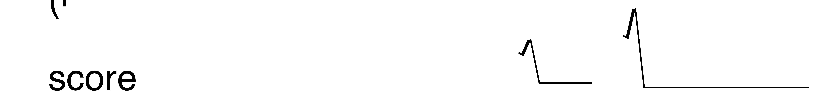
Ranking formulae
Ranking formulae has to depend on need and importance
Focus on structural methods and frequency
Importance can be introduced by citation rank or pageRank or others
SF.IFF
  Substructure frequency and inverse formula frequency
Frequency searches
  where |f| is the total frequency of elements
Substructure search
  where W_{match(q,f)} is the weight for exact match, reverse match, and parsed match
Similarity search

Slide 30
Formula Search extended
Conjunctive search of the basic types of formula searches
  E.g. [*C2H4-6 -COOH] matches CH3COOH, not C2H4O or CH3CH2COOH.
Document query rewriting
  E.g. document query atom formula:=CH4 is rewritten to atom (CH4 OR CD4), if formula search of =CH4 matches CH4 and CD4.

Slide 31
Architecture and Framework
Web
Web Server
Web Service
Documents URL
Query
Focused Crawler
Documents PDF
Document
Query
Formula
Query
Name
Query
Structure
Query
Converter
Document
Ranking
Formula
Ranking
Name
Ranking
Structure
Ranking
Pre-Process
Document DB
Meta-Data
Document
Index
Formula
Index
Name
Index
Structure DB
Structure
Index
Documents TXT
Chemical Structure
Information Extraction
Formulas/Names
Documents
Document
Indexing
Formula
Indexing
Name
Indexing
Structure
Indexing
Parsers & Analyzers
Substrings
Text Feature Selection & Segmentation
Graph Mining and Feature Selection
Chemical Structure
Notes:
2 search engines, 3 stages

Slide 32
Experimental Data Search
Correct semantics of data and its attributes known to the users that generate the dataset.
Need annotations to describe the datasets.
Data in spreadsheets:
Develop tools that enable data publishers to provide document-level and attribute-level metadata.
OAI-PMH format data representation.
Browse and search on attribute and semantic levels.
Link to existing scientific literature.
Data from simulations:
More structured output.
User annotates data in DC metadata format.
Provide automated methods to tag, search and rank this data.

Slide 33
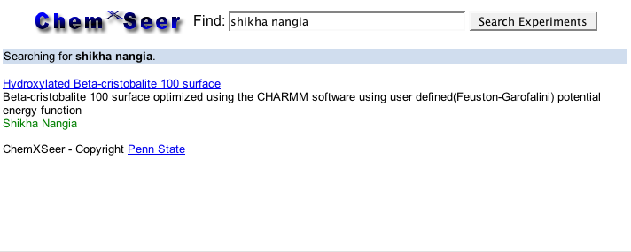
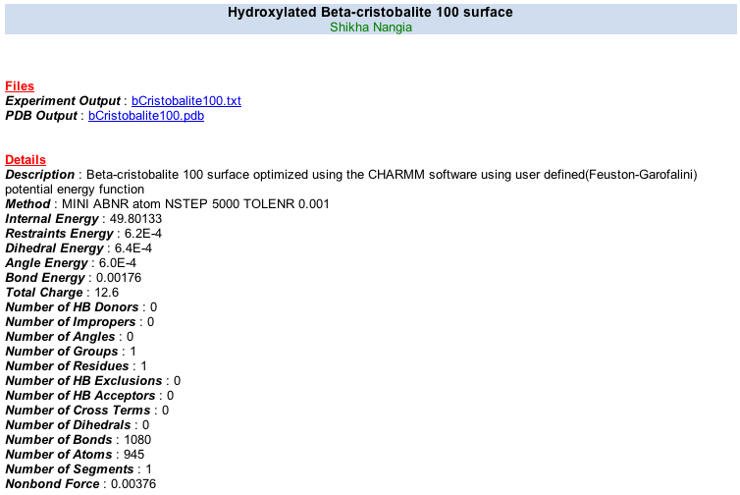
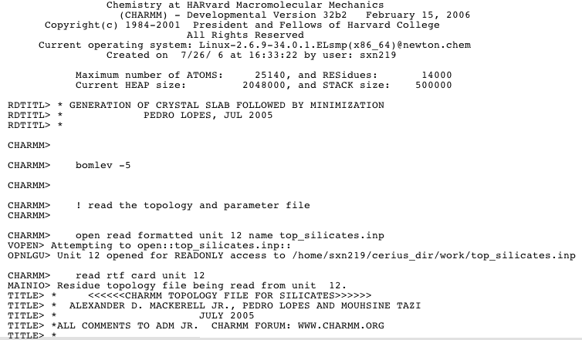
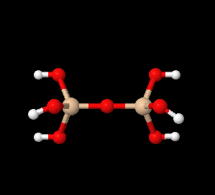
Data Search Example in Chem_{X}Seer
Search document content and metadata

Slide 34
Chem_{X}Seer Table Search
Tables are widely used to present experimental results or statistical data in scientific documents.
Existing search engines treat tabular data as regular text
  Structural information and semantics not preserved.
Automatically identify tables and extract table metadata in xml
Table Metadata Representation:
Environment metadata: (document specifics: type, title,…)
Frame metadata: (border left, right, top, bottom, …)
Affiliated metadata: (Caption, footnote, …)
Layout metadata: (number of rows, columns, headers,…)
Cell content metadata: (values in cells)
Type metadata: (numeric, symbolic, hybrid, …)
Y. Liu, et.al, AAAI 2007, JCDL 2007.

Slide 35
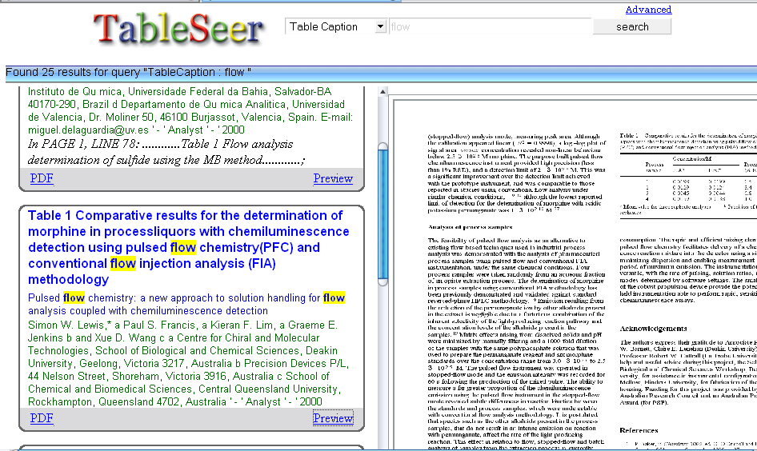
TableSeer
Beta online working design of a table search engine

Slide 36
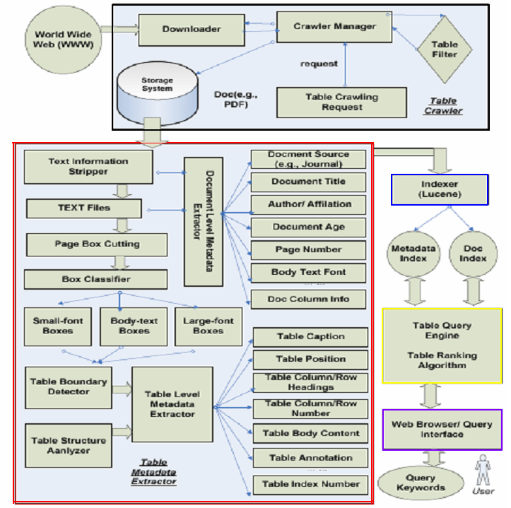
TableSeer
System
Architecture

Slide 37
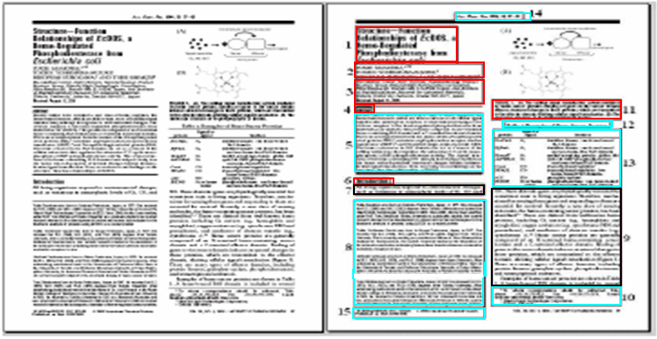
Page Box-Cutting Algorithm
Improves the table detection performance by excluding more than 93.6% document content in the beginning

Slide 38
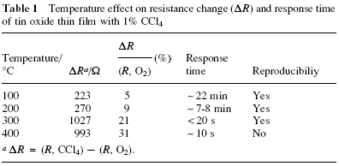
Sample Table Metadata Extracted File
<Table>
<DocumentOrigin>Analyst</DocumentOrigin>
<DocumentName>b006011i.pdf</DocumentName>
<Year>2001</Year>
<DocumentTitle>Detection of chlorinated methanes by tin oxide gas sensors </DocumentTitle>
<Author>Sang Hyun Park, a ? Young-Chan Son, a Brenda R . Shaw, a Kenneth E. Creasy,* b and Steven L. Suib* acd a Department of Chemistry, U-60, University of Connecticut, Storrs, C T 06269-3060</Author>
<TheNumOfCiters></TheNumOfCiters>
<Citers></Citers>
<TableCaption>Table 1 Temperature effect o n r esistance change ( D R ) and response timeof tin oxide thin film with 1 % C Cl 4</TableCaption>
<TableColumnHeading>D R Temperature/ ¡ã C D R a / W ( R ,O 2 ) (%) R esponse time Reproducibiliy </TableColumnHeading>
<TableContent>100 223 5 ~ 22 min Yes 200 270 9 ~ 7-8 min Yes 300 1027 21 < 2 0 s Yes 400 993 31 ~ 1 0 s No </TableContent>
<TableFootnote> a D R =( R , CCl 4 ) - ( R ,O 2 ). </TableFootnote>
<ColumnNum>5</ColumnNum>
<TableReferenceText>In page 3, line 11, … Film responses to 1% CCl4 at different temperatures are summarized in Table 1……</TableReferenceText>
<PageNumOfTable>3</PageNumOfTable>
<Snapshot>b006011i/b006011i_t1.jpg</Snapshot>
</Table>

Slide 39

TableRank
Rank tables by rating the <query, table> pairs, instead of the <query, document> pairs: preventing a lot of false positive hits for table search, which frequently occur in current web search engines
The similarity between a <table, query> pair: the cosine of the angle between vectors
Tailored term vector space => table vectors:
  Query vectors and table vectors, instead of document vectors

Slide 40

Term Weighting
  TTF – ITTF: (Table Term Frequency-Inverse Table Term Frequency)
  TLB: Table Level Boost Factors (e.g., table frequency)
  DLB: Document Level Boost factors (e.g., journal/proceeding order, document citation)

Slide 41



The Term Level
A term occurring in a few tables is likely to be a better discriminator than a term appearing in most or all tables
Similar to document abstract, table metadata and table query should be treated as semi-structured text
  Not complete sentences and express a summary
  P = 0.5 (G. Salton 1988)
b is the total number of tables
IDF(ijk): the number of tables that term t(i) occurs in the matadata m(k)

Slide 42


Table Level Boost and Document Level Boost
B_{tbf} is the boost value of the table frequency
B_{trt} is the boost value of the table reference text (e.g., the normalized length), and B_{tp} is the boost value of the table position. r is a parameter, which is 1 if users specify the table position in the query. Otherwise, r = 0.
IV_{j:} document Importance Value (IV). If a table comes from a document with a high IV , all the table terms of this document should get a high document level boost
IC_{j}: the inherited citation value (ICj)
DO_{j:} source value (the rank of the journal/conference proceeding)
DF_{j}: document freshness

Slide 43
Table citation network
Similar to the PageRank network
  Documents construct a network from the citations
  The “incoming links” – the documents that cite the document in which the table is located
  Exponential decay used to deal with the impact of the propagated importance
Unlike the PageRank network
  Directed Acyclic Graph
  Importance Value (IV) of a document not decreased as the number of citations increases
  IV not divided by the number of outbound links
A document may have multiple, one, or no tables
Each table is consisted as a set of metadata
Same keywords may appear in different metadata in different tables

Slide 44
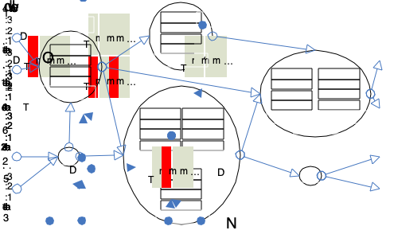
An Example of the Citation Network

Slide 45
Contribution
An novel first time table ranking algorithm -- TableRank
A tailored table term vector space
An innovative table term weighting scheme – TTF-ITTF
  Aggregating impact factors from three levels: the term, the table, and the document
Index table referenced texts, term locations, and document backgrounds
Design and implement a table search engine, TableSeer, to evaluate the TableRank and compare with popular web search engines

Slide 46
Status of Table Search
An novel first table ranking algorithm -- TableRank
A tailored table term vector space
An innovative table term weighting scheme – TTF-ITTF
  Aggregating impact factors from three levels: the term, the table, and the document
Index table referenced texts, term locations, and document backgrounds
Design and implement first table search engine, TableSeer, to evaluate the TableRank and compare with popular web search engines
Currently implement in CiteSeerX - millions of tables

Slide 47
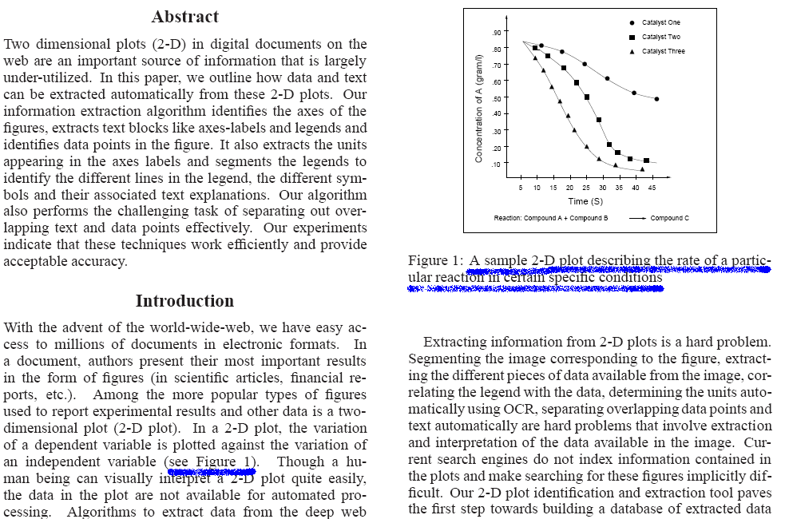
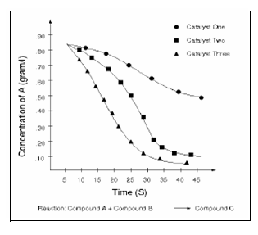
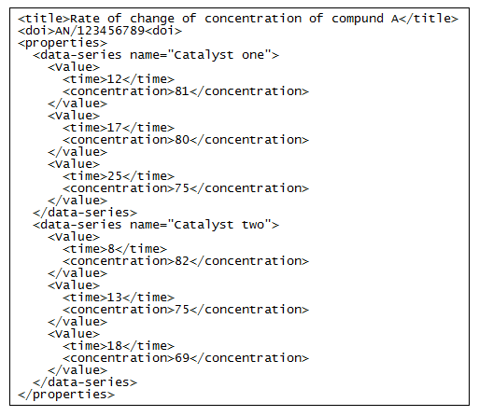

Automated Figure Data Extraction and Search
Large amount of results in digital documents are recorded in figures, time series, experimental results (eg., NMR spectra, income growth)
Extraction for purposes of:
  Further modeling using presented data
  Indexing, meta-data creation for storage & search on figures for data reuse
Current extraction done manually!
Documents
Extracted Plot
Extracted Info.
Document Index
Merged Index
Plot Index
Digital Library
User
Notes:
47

Slide 48
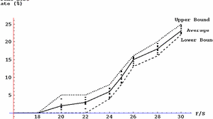
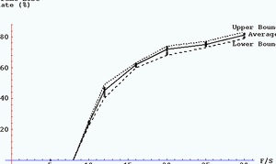
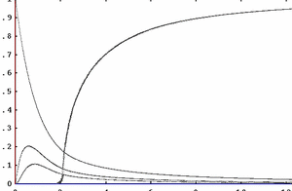
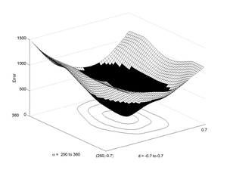
Chem_{X}Seer Figure/Plot Data Extraction and Search
Numerical data in
scientific publications
are often found in figures.
Tools that automate the data extraction from figures provide the following:
Increases our understanding of key concepts of papers
Provides data for automatic comparative analyses.
Enables regeneration of figures in different contexts.
Enables search for documents with figures containing specific experiment results.
X. Lu, et.al, JCDL 2006, Kataria, et.al, 2008

Slide 49
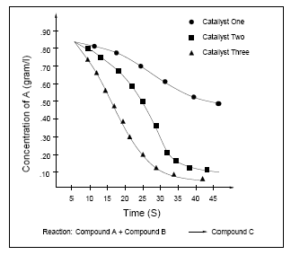
Metadata & data to extract:
2 Dimensional Plot
Y-Axis Labels
Legend
Data Points
Ticks
Axis Units
X-Axis Label
Snapshot of a document
Extracted 2D plot
Notes:
49

Slide 50
Our Approach to Plot Data Extraction
Identify and extract figures from digital documents
  Ascii and image extraction (xpdf)
  OCR - bit map, raster pdfs
Identify figures as images of 2D plots using SVM (Only for Bit
map images)
  Hough transform
  Wavelets coefficients of image
  Surrounding text features
Binarization of the 2D plots identified for preprocessing (No
need for Vectorized Images)
  Adaptive Thresholding
Image segmentation to identify regions
  Profiling or Image Signature
Text block detection
  Nearest Neighbor
Data point detection
  K-means Filtering
Data point disambiguation for overlapping points
  Simulated Annealing

Slide 51
System Overview: Automatic Figure Information Extraction
Figure
doc
Pre-process, identify
segment
Axes
indices
Plot data
pixel region
Axes pixel
regions
CCL,
Fuzzy line filter
Text Filter
Tick Period,
axis classification
Text Filter
Labelled
Points
Text Segmentation,
Disambiguation,
Optical Character
Recognition
Text Segmentation,
Disambiguation,
Optical Character
Recognition
Shape Analysis,
Disambiguation
Legend
Text
Axis labels,
tic labels
Data Series
Notes:
51

Slide 52
2D Plot Identification
Features
  Distribution of wavelet coefficients of the grey-scale image (helps separating picture and non-picture images (Jia Li et al.))
  Axis information i.e. length & position of two longest perpendicular straight lines obtained by Hough transform and profiling
  Further supported/validated by profile based heuristics, e.g., axes correspond to maxima in pixel projections in orthogonal directions
  Textual features that surrounds the image in the document
Classifier:
  Linear support vector machine
Notes:
52

Slide 53
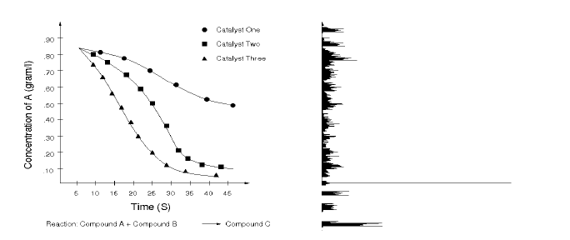
Image Segmentation to Detect Regions
Detection of axes using horizontal & vertical profiles (image signatures)
  Works very well for properly aligned axis
  Realign in case of slightly slanted plot using hough transform
Horizontal profile of the 2-D plot

Slide 54
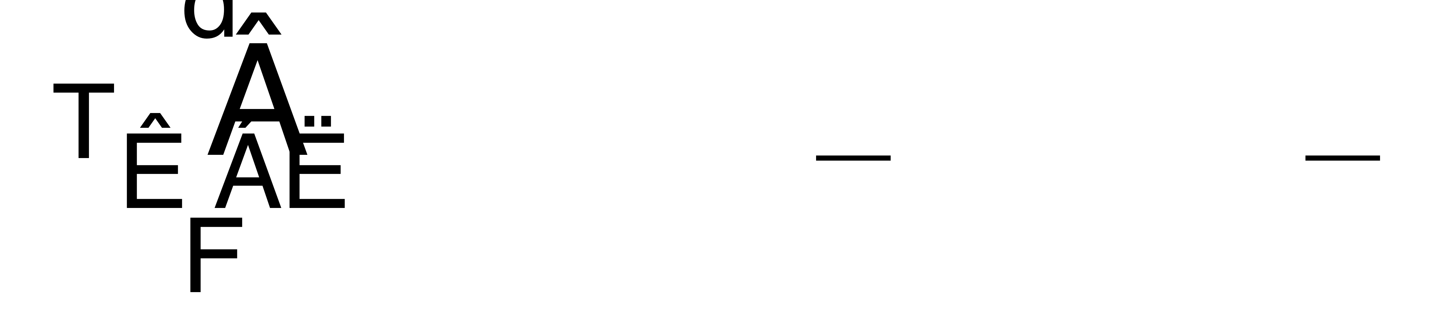
Tic Period Determination
Pixel regions immediately adjacent to axes give absolute measure to indices of data points extracted from data region, may be contaminated by noise and presence of smaller ticks
Alleviate using FFT & properties of Dirac function comb:
Numerical tick period is difference between largest two peaks in twice FFT’d pixel projection data, pattern may also be used for classification (eg., log, linear etc)
Tick period
Tick period
Linear axis
Log axis
Pixel projection
Pixel projection
Notes:
54

Slide 55





Text Block Detection for Legend/Label Extraction
Cluster Connected Components based upon their positions
  Characters in a text string are placed in a spatially coherent way
    Exact spacing between characters varies
    Also, different fonts have different shapes and spacings.
  Solution: model the spacing as fuzzy rules and encode the rules as Gaussian units.
  Apply Nearest Neighbor Classification for clustering strings of text
  Merge Component Clusters if D(.) > “pre-specified” value, where
  and
  d(.) models the fuzzy-ness. Here, = deviation from mean horizontal spacing (pixels) & = allowed spread for horizontal spacing. Also v stands for vertical.

Slide 56
Experimental Results
2-D plot detection achieves 88.25% accuracy on a set of randomly selected ~2500 images. The wavelet features were found to be most important features.
Text Block detection works fairly well in X/Y region but deteriorates in legend region
 | Total | Correctly Identified | % Recall | % Precision
X-Label | 504 | 428 | 84.9 | 96
Y-Label | 504 | 441 | 87.5 | 96
Legend | 504 | 398 | 79.0 | 95
Data points extraction reaches up to 92% recall. However, the precision drops to 76%. We intend to improve the precision by incorporating shape detection while data point extraction rather than at a later stage.
Total | Correct | Recall % | Precision %
504 | 463 | 92 | 76

Slide 57






Examples of Machine Learned Overlapping Points
Simulated annealing gives excellent results for retrieving both data identity and coordinate information, even in the presence of noise.
Shape | Total | #Correct | %Recall
Diamond | 72 | 64 | 88.9
Triangle | 78 | 71 | 91.0
Notes:
57

Slide 58
Optical Character Recognition & Issues
Problem considered ‘solved’ for conventional, well posed text
Figures provide challenges in that text is located amongst extraneous objects
Use heuristics to extract eg., axis text labels lie outside axes
Additional challenges arise from a) overlap between characters and b) arbitrary orientations c) presence of extraneous objects eg., lines
A custom algorithm has been devised for a)
Problems b) and c) being treated in current work; once text is appropriately segmented, conventional OCR works very well eg., latest release GOCR and OCRopus
Notes:
58

Slide 59
2 dimensional figures are largely ignored in digital libraries yet contain valuable information
Nearest Neighbor clustering based text block detection that improves OCR performance.
Data point and lines segregation
Simulated annealing based overlapping data point disambiguation
System integration within Chem_{X}Seer or CiteSeer^{X}
  XML data generation
  Open source tool for Lucene/SOLR
Extension to other figures (3D, …)
Notes:
59

Slide 60
Chem_{X}Seer Figure/Plot Data Extraction
Numerical data in
scientific publications
are often found in figures.
Tools that automate the data extraction from figures provide the following:
Increases our understanding of key concepts of papers
Provides data for automatic comparative analyses.
Enables regeneration of figures in different contexts.
Enables search for documents with figures containing specific experiment results.
X. Lu, et.al, JCDL 2006.

Slide 61
Our Approach to Plot Data Extraction
Identify and extract figures from digital documents
  Ascii and image extraction (xpdf)
  OCR - bit map, raster pdfs
Identify figures as images of 2D plots using SVM (Only for Bit
map images)
  Hough transform
  Wavelets coefficients of image
  Surrounding text features
Binarization of the 2D plots identified for preprocessing (No
need for Vectorized Images)
  Adaptive Thresholding
Image segmentation to identify regions
  Profiling or Image Signature
Text block detection
  Nearest Neighbor
Data point detection
  K-means Filtering
Data point disambiguation for overlapping points
  Simulated Annealing

Slide 62
System Management - web services
Integrate application components within a high-performance, scalable, fault-tolerant framework
Facilitate development of application components
  Include discrete programmatic tasks as plugins
  Reduce burden on developers – focus only on novel tasks and the framework, not re-working legacy code
  Ease the process of re-configuring application logic
Ideas from inversion of control (IOC) design pattern
  Remove implicit dependencies among discrete units of code, make them explicit through configuration at the framework level
  Move control away from application logic, into framework
  Facilitate monitoring/management of individual program tasks
  Configure dependencies and control flow through BPEL

Slide 63
Some Related Work
Chemistry
Chemical markup language [Murray-Rust, JCICS 2003]
IChI/InChI [Adam , Nature 2002]
  IUPAC International Chemical Identifier
  A string of characters capable of uniquely representing a chemical substance
Oscar3 [Corbett, CompLife 2006]
  Chemical formula and name tagger
World Wide Molecular Matrix Web Services
  Structure to InChI Server
  Web search using InChI [Coles, OBC 2005]
Several Commercial Systems
Computer Science
Entity Extraction
  Name entity [McCallum, CoNLL 03], protein [Settles, Bioinformatics 05], gene [McDonald, Bioinformatics 05], etc.
Methods:
  Hidden Markov Models [Freitag, AAAI 99], Maximum Entropy [Borthwick, 99], Conditional Random Fields [Lafferty, ICML 01], Support Vector Machines [Joachims, 02]
Graph Similarity Search
  Substructure search [Yan, SIGMOD 04]
  Similarity search [Willet, JCICS 98] [Yan, SIGMOD 05]

Slide 64
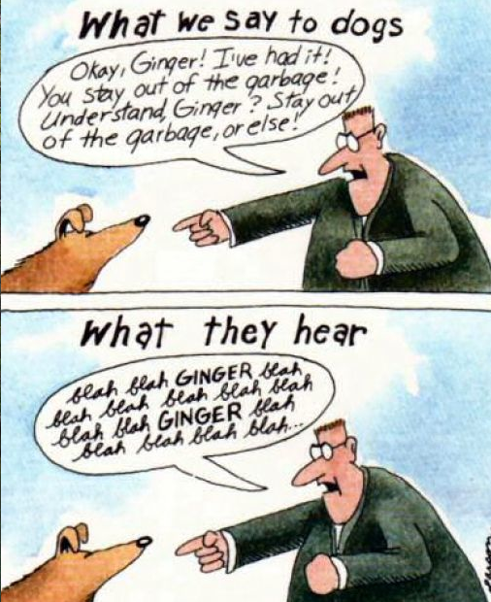
Low level semantics.
How does all this fit together?

Slide 65
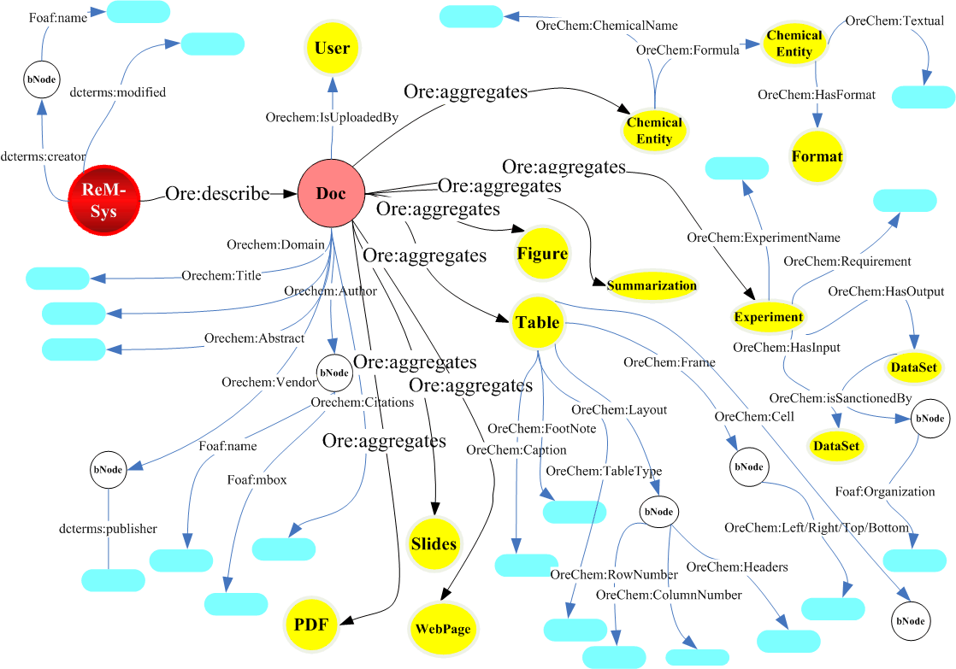
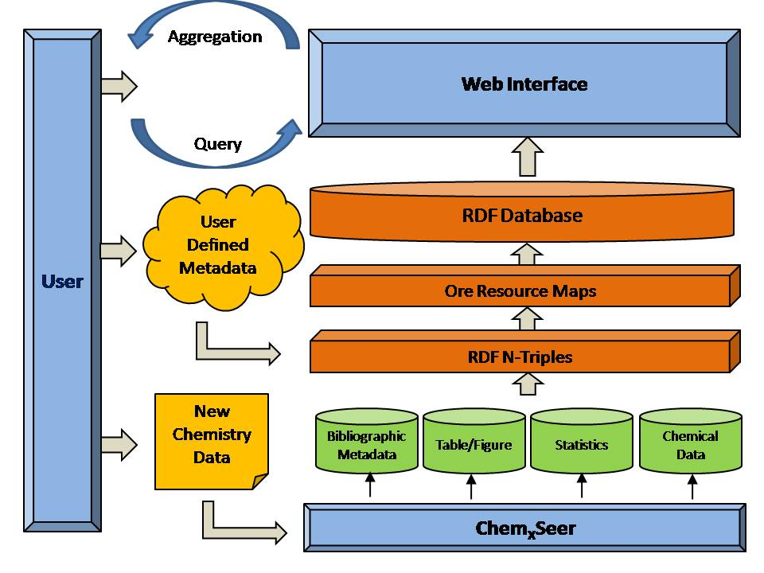
oreChem in Chem_{X}Seer
Microsoft support: Penn State, Indiana, Cambridge, Southampton, Cornell, Los Alamos, Queensland
Li, et.al JCDL2010
oreChem Chem_{X}Seer defines several aggregations for exchange and reuse of data and metadata in Chemistry. Proposed RDF aggregations are for the following resources:
orechem:aggregatesdoc: title, abstract, citations, etc.
orechem:aggregatesauthor: name, affiliations, etc.
orechem:aggregatesvenue: name, year, month, etc.
orechem:aggregatestable: header, cell contents, etc.
orechem:aggregatesformula: name, structure, etc
Current implementation in ORE with
2 million triples for 150K docs. Search?

Slide 66
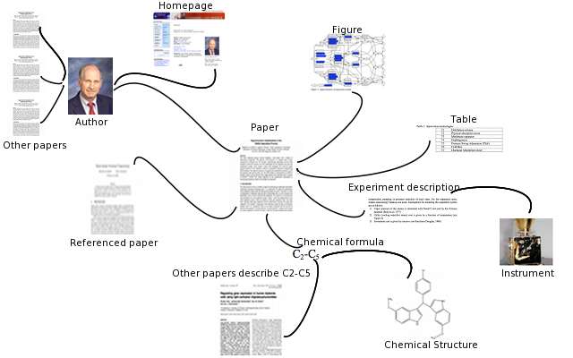
Ontologies - RDF

Slide 67
Named Entity Extraction
OAI type Metadata
  Title
  Authors - collaborators
  Abstract
  Venue
  Year
  Citation
Obtained from ChemXSeer digital library via CiteSeerX
Chemistry Specific Metadata
  Chemical Formula
  Images (MRI, Spectrum, …)
  Tables
  Experiments

Slide 68
Object Reuse and Exchange - ORE
(Lagoze, et al.)
Aggregation, aggregated resource, resource map, proxy
Aggregation: resource of type ore:Aggregation
  Set of other resources
Aggregated resource: constituent of an aggregation
Resource map: describes a single aggregation
  Contains provenance information of constituents of the aggregation
Aggregation can have many resource maps

Slide 69
oreChem in Chem_{X}Seer
oreChem Chem_{X}Seer defines several aggregations for exchange and reuse of data and metadata in Chemistry. Proposed rdf aggregations are for the following resources:
orechem:aggregatesdoc: title, abstract, citations, etc.
orechem:aggregatesauthor: name, affiliations, etc.
orechem:aggregatesvenue: name, year, month, etc.
orechem:aggregatestable: header, cell contents, etc.
orechem:aggregatesformula: name, structure, etc
Store metadata in RDF repository
  Sesame’s Named Graphs
    Context: Document Aggregation
ORE objects stored logically
  Logical views: how to create them
  Future: performance issues
    Physical views
Current implementation in ORE with
2 million triples for 150K docs.
Indexed in Sesame
Based on ORE – Lagoze, et.al

Slide 70
Reuse Existing Standards
Dublin Core: Document Metadata
FOAF Ontology: Person Metadata
ChemAxiom Metrology Ontology: Experiment Metadata
Added our own metadata terms related to chemistry with basic
  concepts like chemical formulae, chemical names
Document elements: tables, figures, etc.
Querying using SerQL
Allow the user to export the ORE objects in Atom, RDF/XML, N3,
N-Triples, Turtle, and RDFa
SVG ORE – graphical visualization (from RDFa via XSLT)

Slide 71
Example of a Chemical
<rdf:Description rdf:about="http://chemxseer.ist.psu.edu/document/10.1039/b402145m">
<ore:aggregates rdf:resource="http://chemxseer.ist.psu.edu/formula/
6- propionyl-2-(N,N-dimethylamino)naphthalene"/>
<orechem:contains rdf:nodeID="A18"/>
</rdf:Description>
<rdf:Description rdf:nodeID="A18">
<dcterms:title>6-propionyl-2-(N,N-dimethylamino)naphthalene
</dcterms:title>
<rdfs:seeAlso rdf:resource="http://chemxseer.ist.psu.edu/formula/
6-propionyl-2-(N,N-dimethylamino)naphthalene"/>
</rdf:Description>

Slide 72
System Overview

Slide 73
OREChem ChemXSeer Data Model
Li JCDL 2010

Slide 74
Chem_{X}Seer Highlights
Portal for academic researchers in environmental chemistry which integrates the scientific literature with experimental, analytical and simulation results and tools
Provides unique metadata extraction, indexing and searching pertinent to the chemical literature by using heuristics combined with machine learning
  Chemical formulae and names
  Tables
  Figures
  Publication functions as in CiteSeerX
  Population of chemical ontology
  OreChem
After extraction, data stored API accessible xml for users
Hybrid repository (Not fully open): Serves as a federated information interoperational system
  Scientific papers crawled and indexed from the web
  User submitted papers and datasets (e.g. excel worksheets, Gaussian and CHARMM toolkit outputs)
  Scientific documents and metadata from publishers (e.g. Royal Society of Chemistry)
Access control for publisher-provided content and user-submitted experiment data
Takes advantage of developments in other funded cyberinfrastructure and open source projects
  CiteSeer^{X}, PlanetLab, Lucene/Solr, Fedora, SeerSuite
  Releases open source

Slide 75
Conclusions/Progress
Chem_{X}Seer portal search engine and data repository for kinetic chemistry now available
  Some code released
Novel information extraction algorithms and search functionalities
  formulae and chemical names
  tables (source code released)
  data
Interoperability through de facto standards
Design emphasis: API’s and integration of existing open source software

Slide 76
Possible new directions
Utilize new SeerSuite tools
  Collaboration recommendation
  Expert recommendation
  Reference-citation recommedation

Slide 77
Enhanced Metadata Extraction
Document
x distance
spacing
Experiments
Experiments
margin
length
Take advantage of addition features linked to layouts – position, font changes
Modify both document converter (provide more information) and extractor (to utilize more information).
Current status – 87 % CV Accuracy across metadata classes.

Slide 78
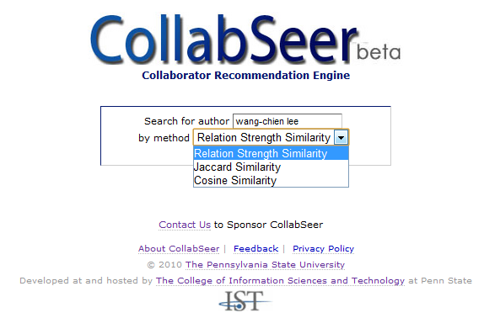
Collaborator recommendation system
JCDL’11
CollabSeer currently supports 400k authors
http://proc5.ist.psu.edu:8080/collabseer
Notes:
Query interface, support 3 vertex similarity measures

Slide 79
Collaboration recommendation
Metadata of authors and coauthors and topics of interest (similar to expert recommendation)
Use social network and topics to recommend collaborators of collaborators (FOF)
Devise SN index and ranking scheme
Explore models of vertex similarity
Built on SeerSuite
Other recommendations?
  Experimental methods
  Chemicals?
Gou JCDL’00,
Gou MIR’00
Chen JCDL’901

Slide 80
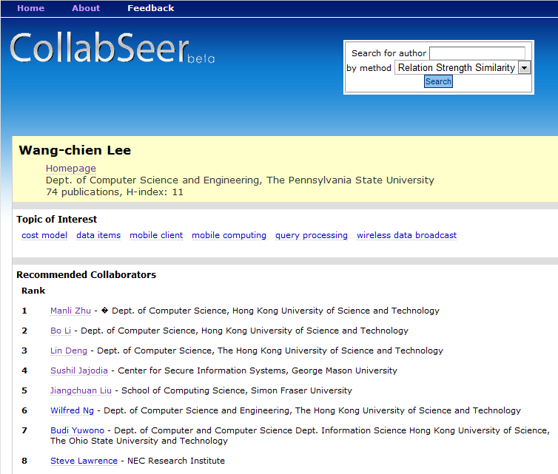
Recommendation list and user’s topic of interest
Notes:
Qui

Slide 81
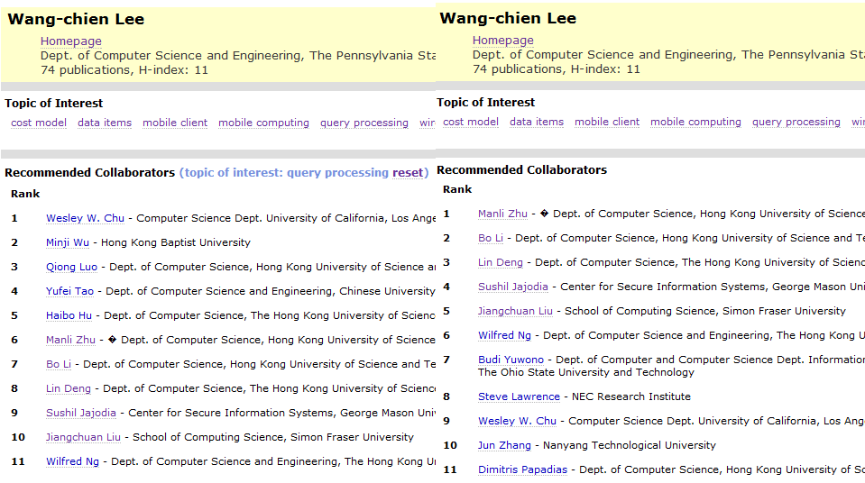
Users refine the recommend list by clicking on their topic of interest. (left: refined by “query processing”, right: default recommendation list)

Slide 82
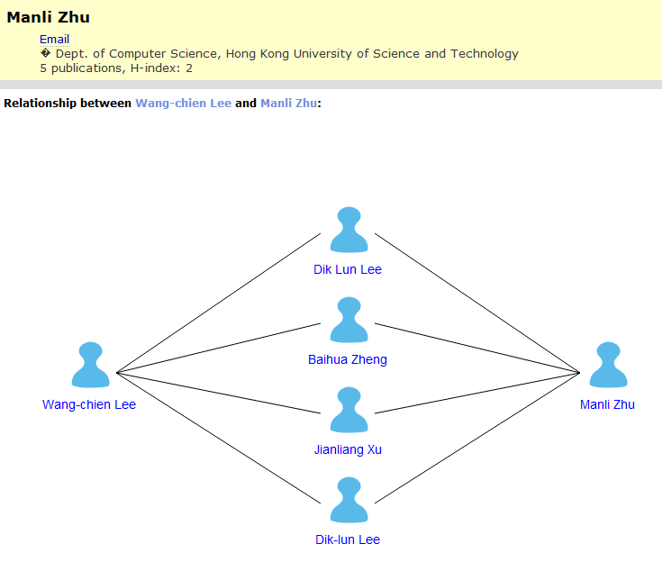
How two potential collaborators are linked by common collaborators

Slide 83
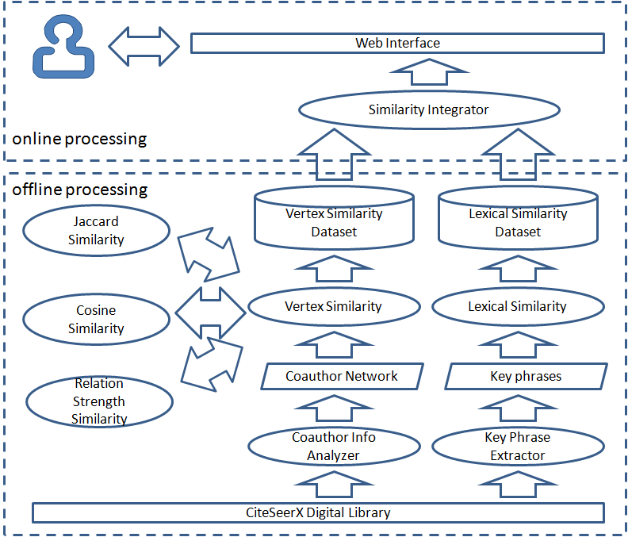
CollabSeer Framework

Slide 84
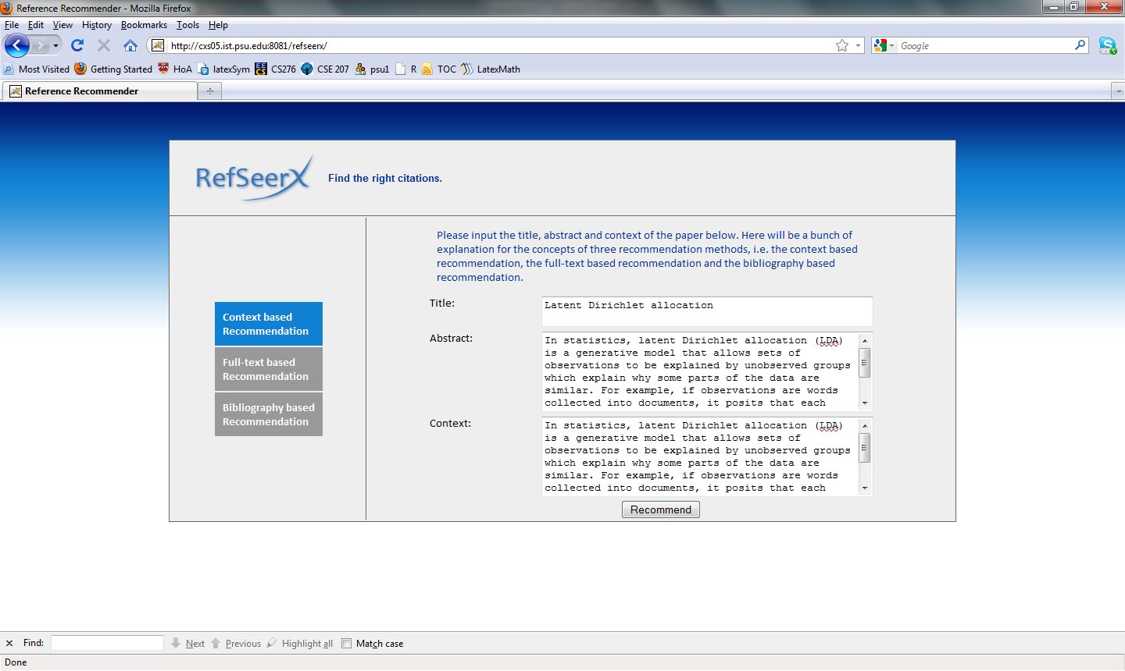
WWW ‘10, CIKM ’10, WSDM ‘11

Slide 85
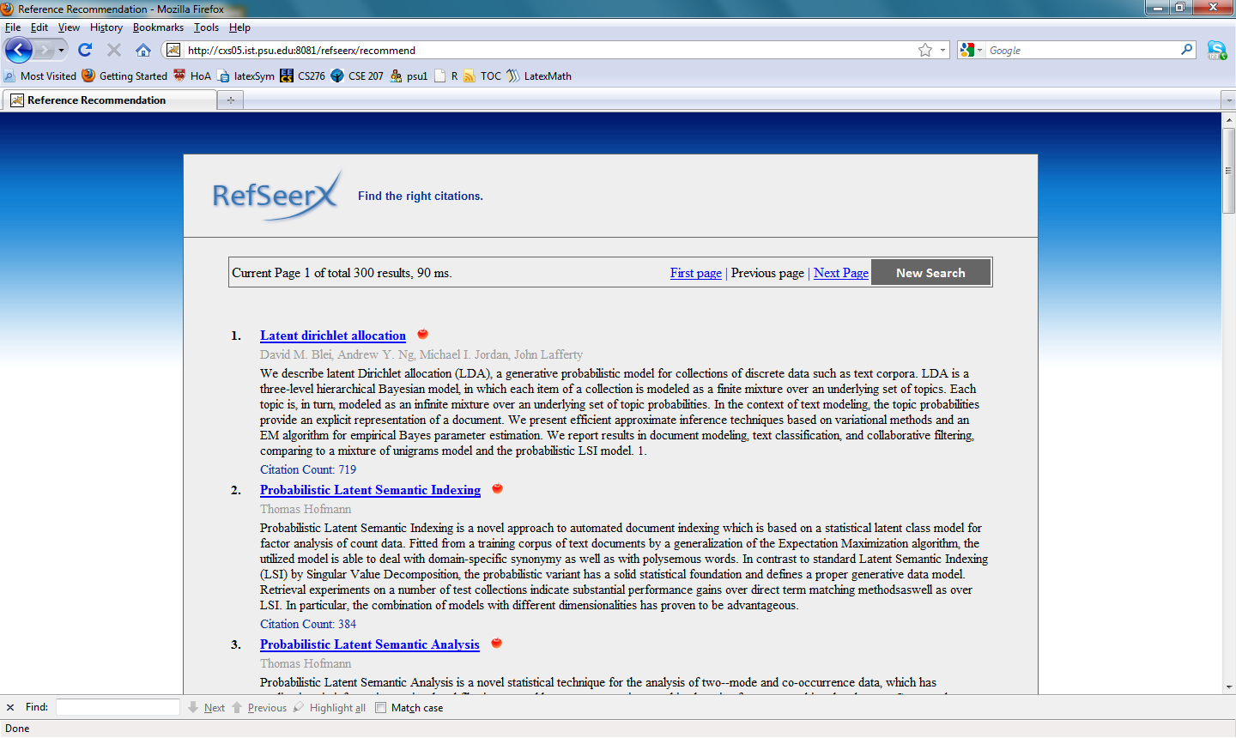

Slide 86
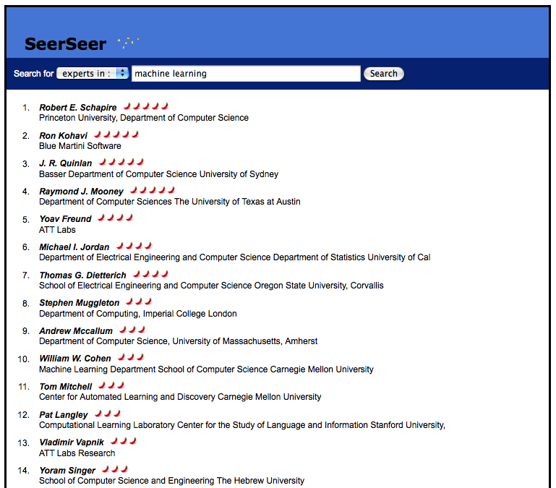
Expert Search
Expert search for authors, currently in alpha

Slide 87
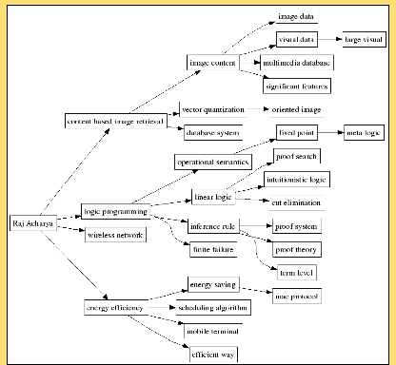
Expert Search
Expert search for authors, currently in alpha

Slide 88
Future Work
Lots of interesting work to do! Few computer and information scientists involved.
Improved search features for tables, chemical formula and figures.
Acquisitions – web based documents and data
Chemical subgraph & 3D graph search
Fundamental chemical graph representation analysis
Table data storage and access
New data search
  spectra, experimental methods, instrumentation
Semantic chemical graphs and information
Search integration of all features
Collaboration and expert recommendation

Slide 89
Recent publications
Please see homepages of C. Lee Giles and Prasenjit Mitra

