Slide 1
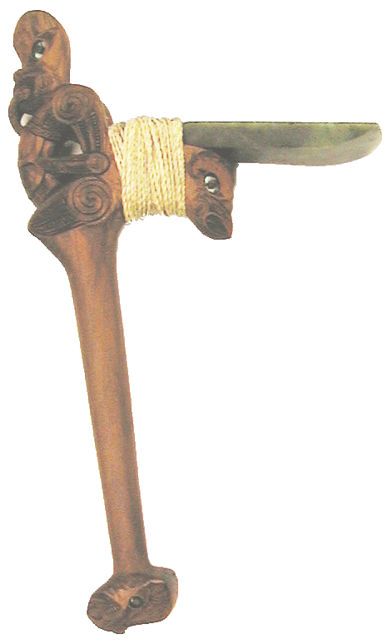
A Musical Progression with Greenstone
How Content Analysis and Linked Data is Helping Redefine Digital Library Software Architecture
David Bainbridge
Computer Science Department Waikato University New Zealand
davidb@cs.waikato.ac.nz
www.greenstone.org cosi.cms.waikato.ac.nz
Notes:
A Musical Progression with Greenstone: How Content Analysis and Linked Data is Helping Redefine Digital Library Software Architecture
Despite the on-line user interface transformation heralded in by the Web 2.0 revolution, conventional digital library software architectures—from which many of our leading Digital Libraries are formed—result in digital resources that are surprisingly static and disconnected from other online sources of information, and embody a “read-only” mindset. Taking a Music Digital Library as an example and leveraging from content analysis techniques and Linked Open Data (LOD), in this talk I will demonstrate a new form digital library that encompasses management, discovery, delivery, and processing of the content it contains—in this case musical content. Utilizing open source tools such as Greenstone, audioDB, and Apache Jena I will present a series of transformations to a musical digital library sourced from audio files that steadily increases the level of support provided to the user for musicological study. While the seed for this work was motivated by better supporting musicologists in a digital library, the developed software architecture alters the boundaries to what is conventionally thought of as a digital library—and in doing so challenges core assumptions made in mainstream digital library software design.

Slide 2
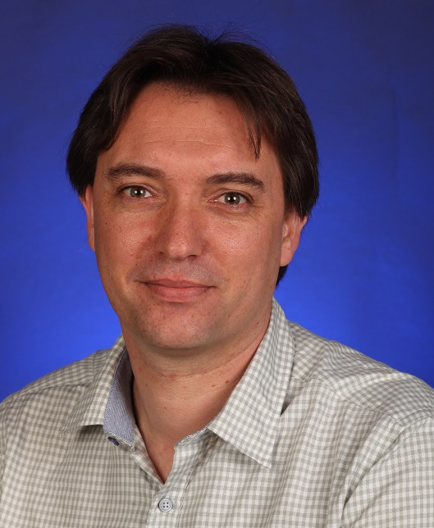
Bio
David Bainbridge is a Professor of Computer Science at the University of Waikato, and Director of the New Zealand Digital Library Research Project. He is an advocate of open source software, and an active coder on the Greenstone digital library project, and the spatial hypermedia system, Expeditee. His research interests include multimedia content analysis, and human computer interaction in addition to digital libraries.
He has published widely in these areas, including the book How to Build a Digital Library, with colleagues Ian Witten and Dave Nichols, now into its second edition. David graduated with a Bachelor of Engineering in Computer Science from Edinburgh University, UK as the class medalist, and undertook his PhD in Computer Science at Canterbury University, New Zealand as a Commonwealth Scholar.
Notes:
Bio: David Bainbridge is a Professor of Computer Science at the University of Waikato, and Director of the New Zealand Digital Library Research Project. He is an advocate of open source software, and an active coder on the Greenstone digital library project, and the spatial hypermedia system, Expeditee. His research interests include multimedia content analysis, and human computer interaction in addition to digital libraries. He has published widely in these areas, including the book How to Build a Digital Library, with colleagues Ian Witten and Dave Nichols, now into its second edition. David graduated with a Bachelor of Engineering in Computer Science from Edinburgh University, UK as the class medalist, and undertook his PhD in Computer Science at Canterbury University, New Zealand as a Commonwealth Scholar.

Slide 3
Outline
Digital Libraries
Working Definition
A Musical (DL) Progression
A Traditional MDL
The Missing Link?
Bells and Whistles
Conclusion

Slide 4
Definition
From the literature, a digital library is:
A focused collection of digital objects
Including text, audio and video
Along with methods for access and retrieval
And for selection, organisation, and maintenance
Notes:
What is a digital library? A simple working definition:

Slide 5
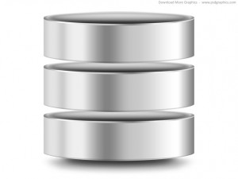
Traditional DL Architecture
Open Archives Initiative Data-Provider
DL Server
Indexer
Database
Dspace, ePrints, Fedora, Greenstone, HathiTrust…

Slide 6
A Traditional Music DL

Slide 7
A Traditional MDL

Slide 8
A Traditional MDL

Slide 9
A Traditional MDL

Slide 10
A Traditional MDL in Greenstone
Open Archives Initiative Data-Provider
Greenstone Server
Lucene
JDBM

Slide 11
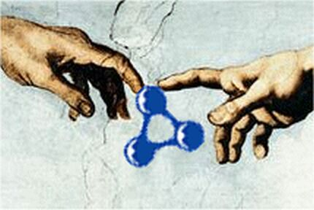
The Missing Link?

Slide 12
The Missing Link?

Slide 13
The Missing Link?

Slide 14
The Missing Link?

Slide 15
The Missing Link?

Slide 16
The Missing Link?

Slide 17
The Missing Link?

Slide 18
The Missing Link?

Slide 19
The Missing Link?
What’s going on here?
MusicIRPlugin
Audio-fingerprinting
Orthogonal Index
Apache Fuseki TDB server
Document.xsl customisation
HTML5 audio
Clasify.xsl customisation
SGVizler Javascript Library

Slide 20
The Missing Link?
Mixing Greenstone XSLT & HTML
<tr>
<td>Artist</td>
<td>
<gsf:metadata name="dc.Creator"/>
</td>
</tr>

Slide 21
The Missing Link?
Mixing Greenstone XSLT, HTML & Microdata:
<tr>
<td>Artist</td>
<td>
<gsf:switch>
<gsf:metadata name="$mb-artistid"/>
<gsf:when test="exists">
<span itemtype="http://musicbrainz.org/artist"
itemid="http://musicbrainz.org/artist/{$mb-artistid}"
itemprop="name">
<gsf:metadata name="dc.Creator"/>
</span>
</gsf:when>
<gsf:otherwise>
<gsf:metadata name="dc.Creator"/>
</gsf:otherwise>
</gsf:switch>
</td>
</tr>

Slide 22
Augmented with Linked Data
MusicBrainz
Echonest
LastFM
Open Archives Initiative Data-Provider
Greenstone Server
Lucene
JDBM
Jena/TDB

Slide 23
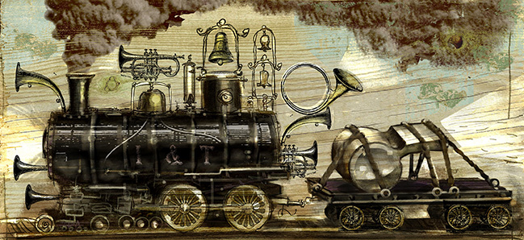
Bells and Whistles

Slide 24
Bells and Whistles

Slide 25
Bells and Whistles

Slide 26
Bells and Whistles

Slide 27
Bells and Whistles

Slide 28
Bells and Whistles

Slide 29
Bells and Whistles

Slide 30
Bells and Whistles

Slide 31
Bells and Whistles

Slide 32
Bells and Whistles

Slide 33
Bells and Whistles

Slide 34
Bells and Whistles

Slide 35
Bells and Whistles

Slide 36
Bells and Whistles

Slide 37
Bells and Whistles

Slide 38
Bells and Whistles

Slide 39
Bells and Whistles

Slide 40
Bells and Whistles

Slide 41
Bells and Whistles
Builds upon Linked Data core, and adds:
AudioDB Orthogonal Index
Document.xsl customization
Meandre Integration
Developed a “Compact” embedded interface
Developed components to “bridge” data in & out
SVG for frequency and self-similarity plot
Pan left and right audio
“data” metadata save

Slide 42
Bells and Whistles
MusicBrainz
Echonest
LastFM
Open Archives Initiative Data-Provider
Greenstone Server
Lucene
JDBM
Jena/TDB
audioDB
Meandre

Slide 43
All in the Browser

Slide 44
All in the Browser

Slide 45
All in the Browser

Slide 46
All in the Browser

Slide 47
All in the Browser

Slide 48
All in the Browser
Utilizing Web Browser audio processing:
Web Audio
Explore the role of:
Annotations for musicological analysis
Goes beyond client-side real-time audio processing:
Uses JsMad library to decode MP3 files
Parasitic Computing for Musicology
…

Slide 49
Conclusion

Slide 50
Conceptually
DL Server
Sparql Endpoint
Workbench
?

Slide 51
What is a Digital Library?
DL definition:
A focused collection of digital objects
Including text, audio and video
Along with methods for access and retrieval
And for selection, organisation, and maintenance
What I’ve shown you today fits into that definition
But is quite different to what is currently on offer
Built out of Open and Smart (arguably) Technologies
Notes:
(hope you agree that)

Slide 52
Conclusion
Need to think of next generation of DL users as being equipped with:
Reading & Writing + Maths & Coding
They will be interested in:
Programmatic data selection, analysis, and generation
Their approach will be splicing snippets of code into existing DL software infrastructure
Think StackOverflow!
Think Pick ‘ n’ Mix
Digital Library environments need to evolve!
Notes:
Building out/Generalizing
Digital Library environments need to evolve:
Programming increasingly being taught at primary school level upwards

Slide 53
Resources
Greenstone:
http://www.greenstone.org
http://trac.greenstone.org
Centre for Open Source Innovation:
http://cosi.cms.waikato.ac.nz

Slide 54
Thank You!
www.greenstone.org

Slide 55
Questions?
www.greenstone.org

